Slide 1
CorDapp Design Language (CDL)
How to Draw a CorDapp and why you should?
Eric McEvoy

Slide 2
The Days of Toy Apps are over
We’re not doing PoCs anymore… production grade Cordapps are more complex
Need more functionality
Must included non-happy path
Privacy must be maintained
Design must be provably robust
We need a way to represent and reason about non-trivial CorDapp designs

Slide 3
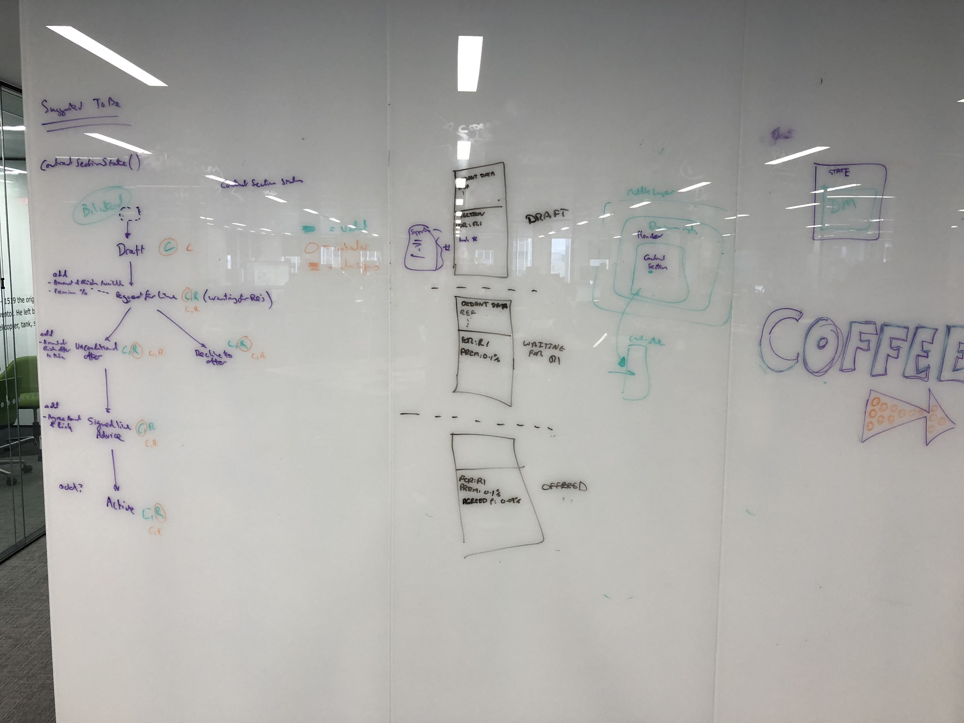
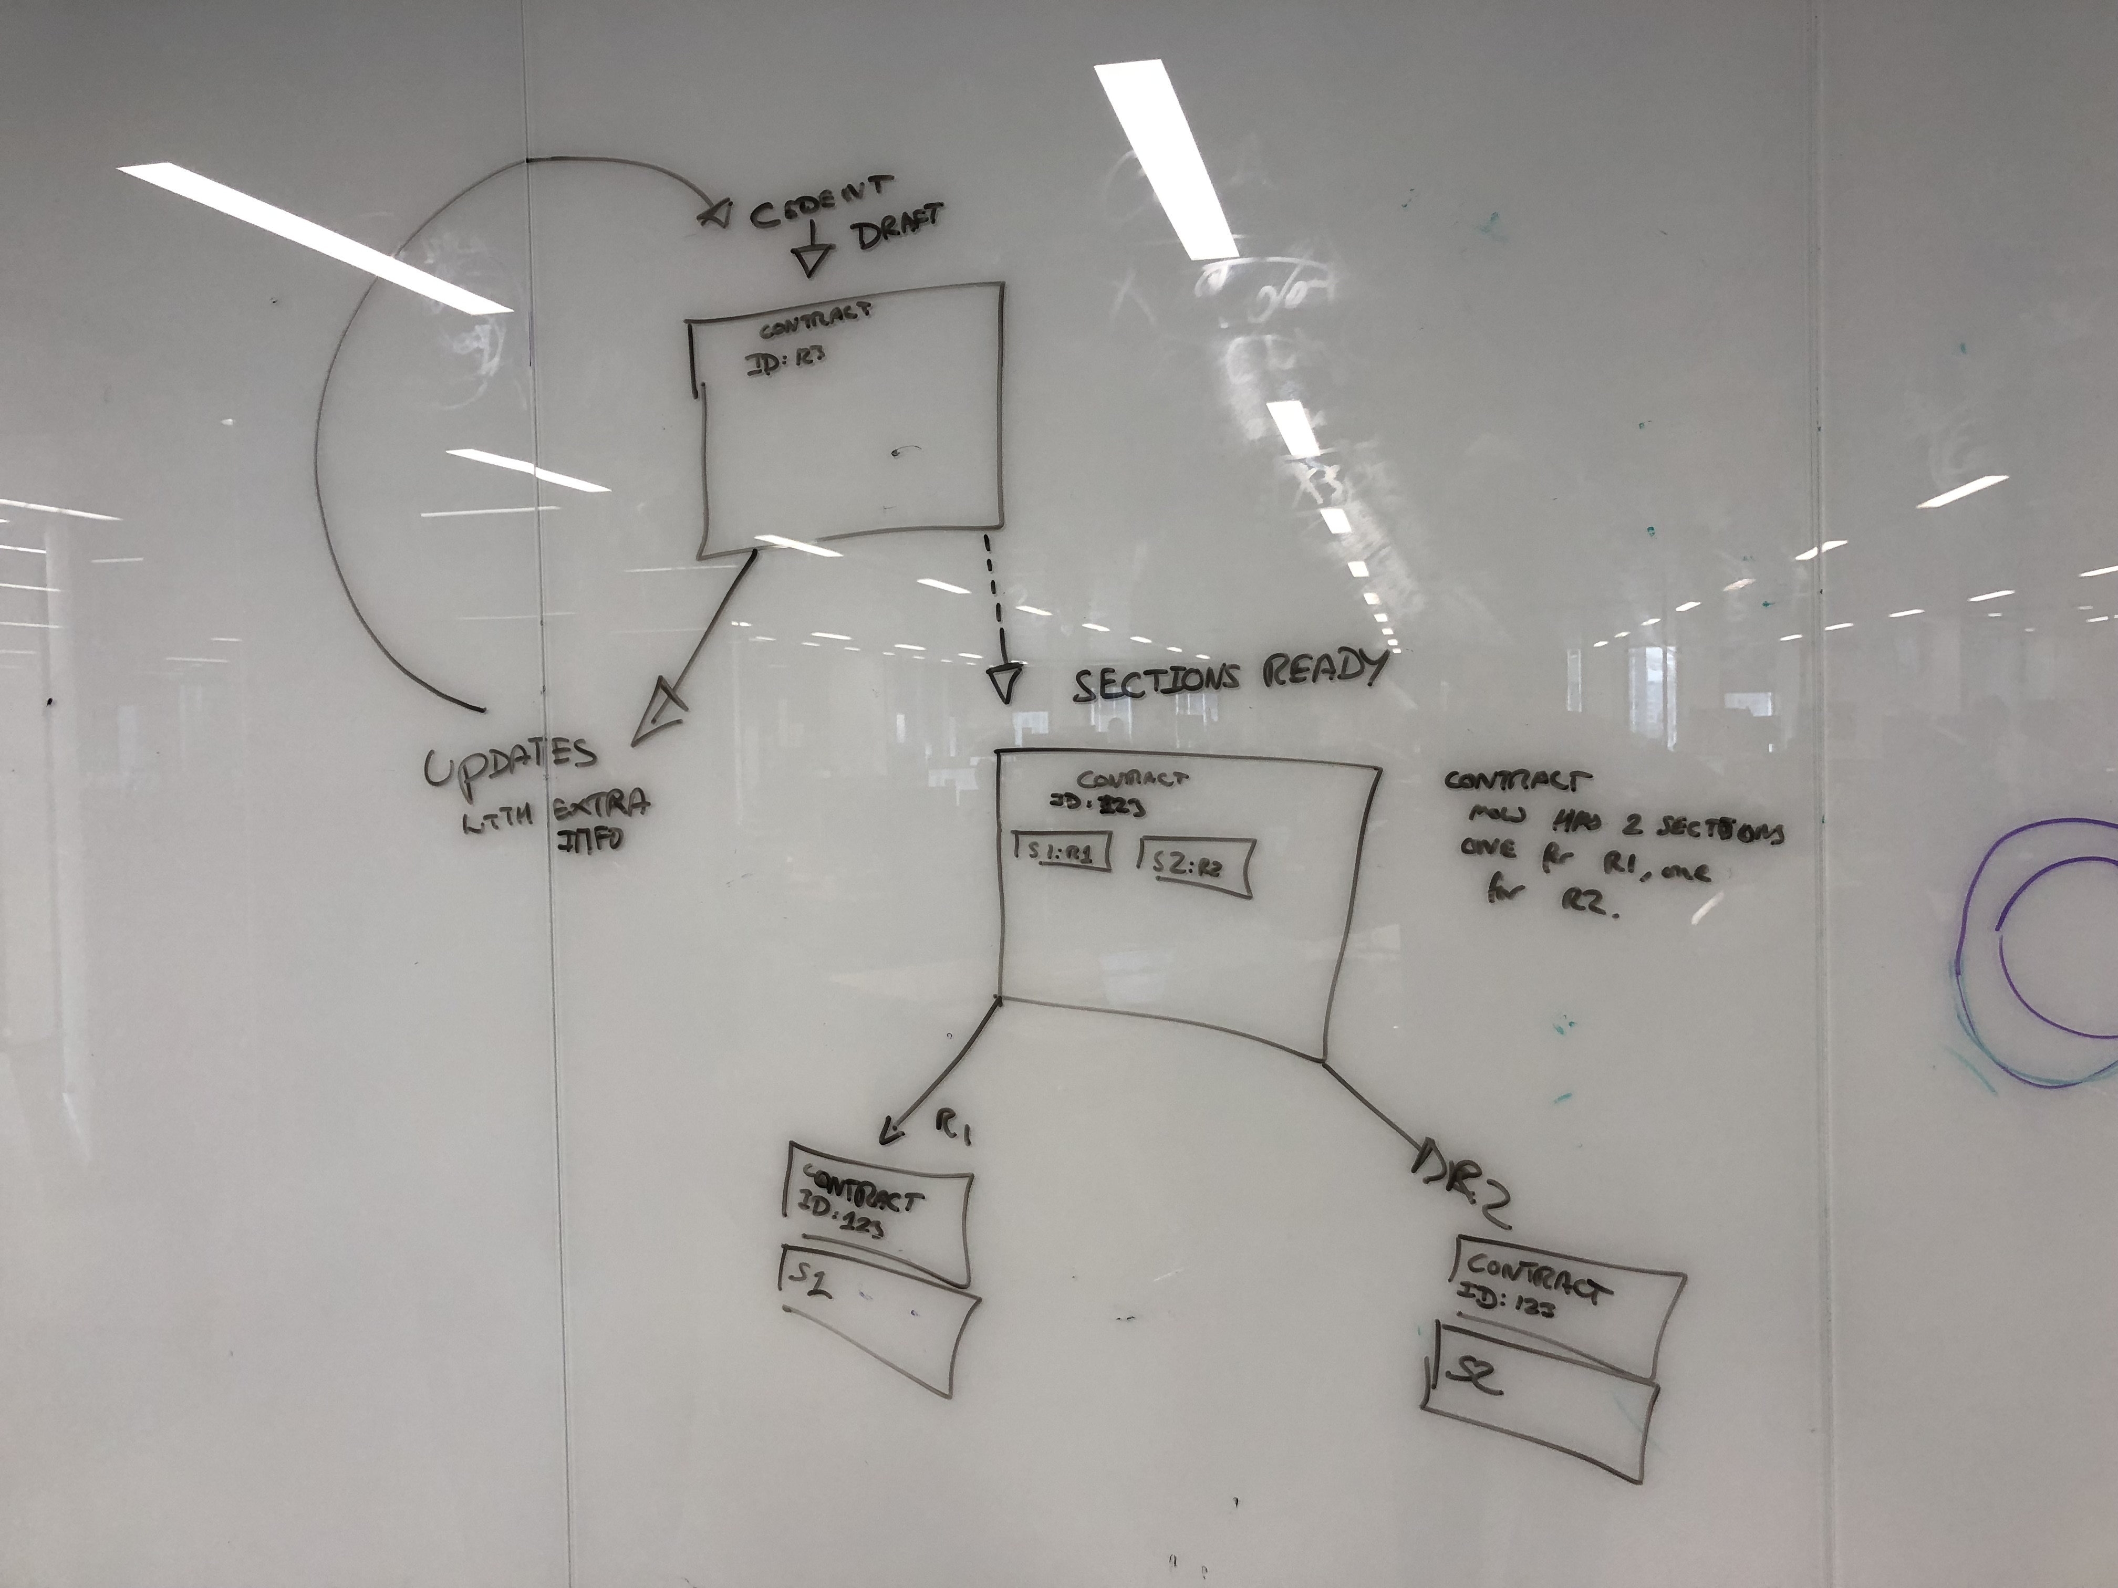
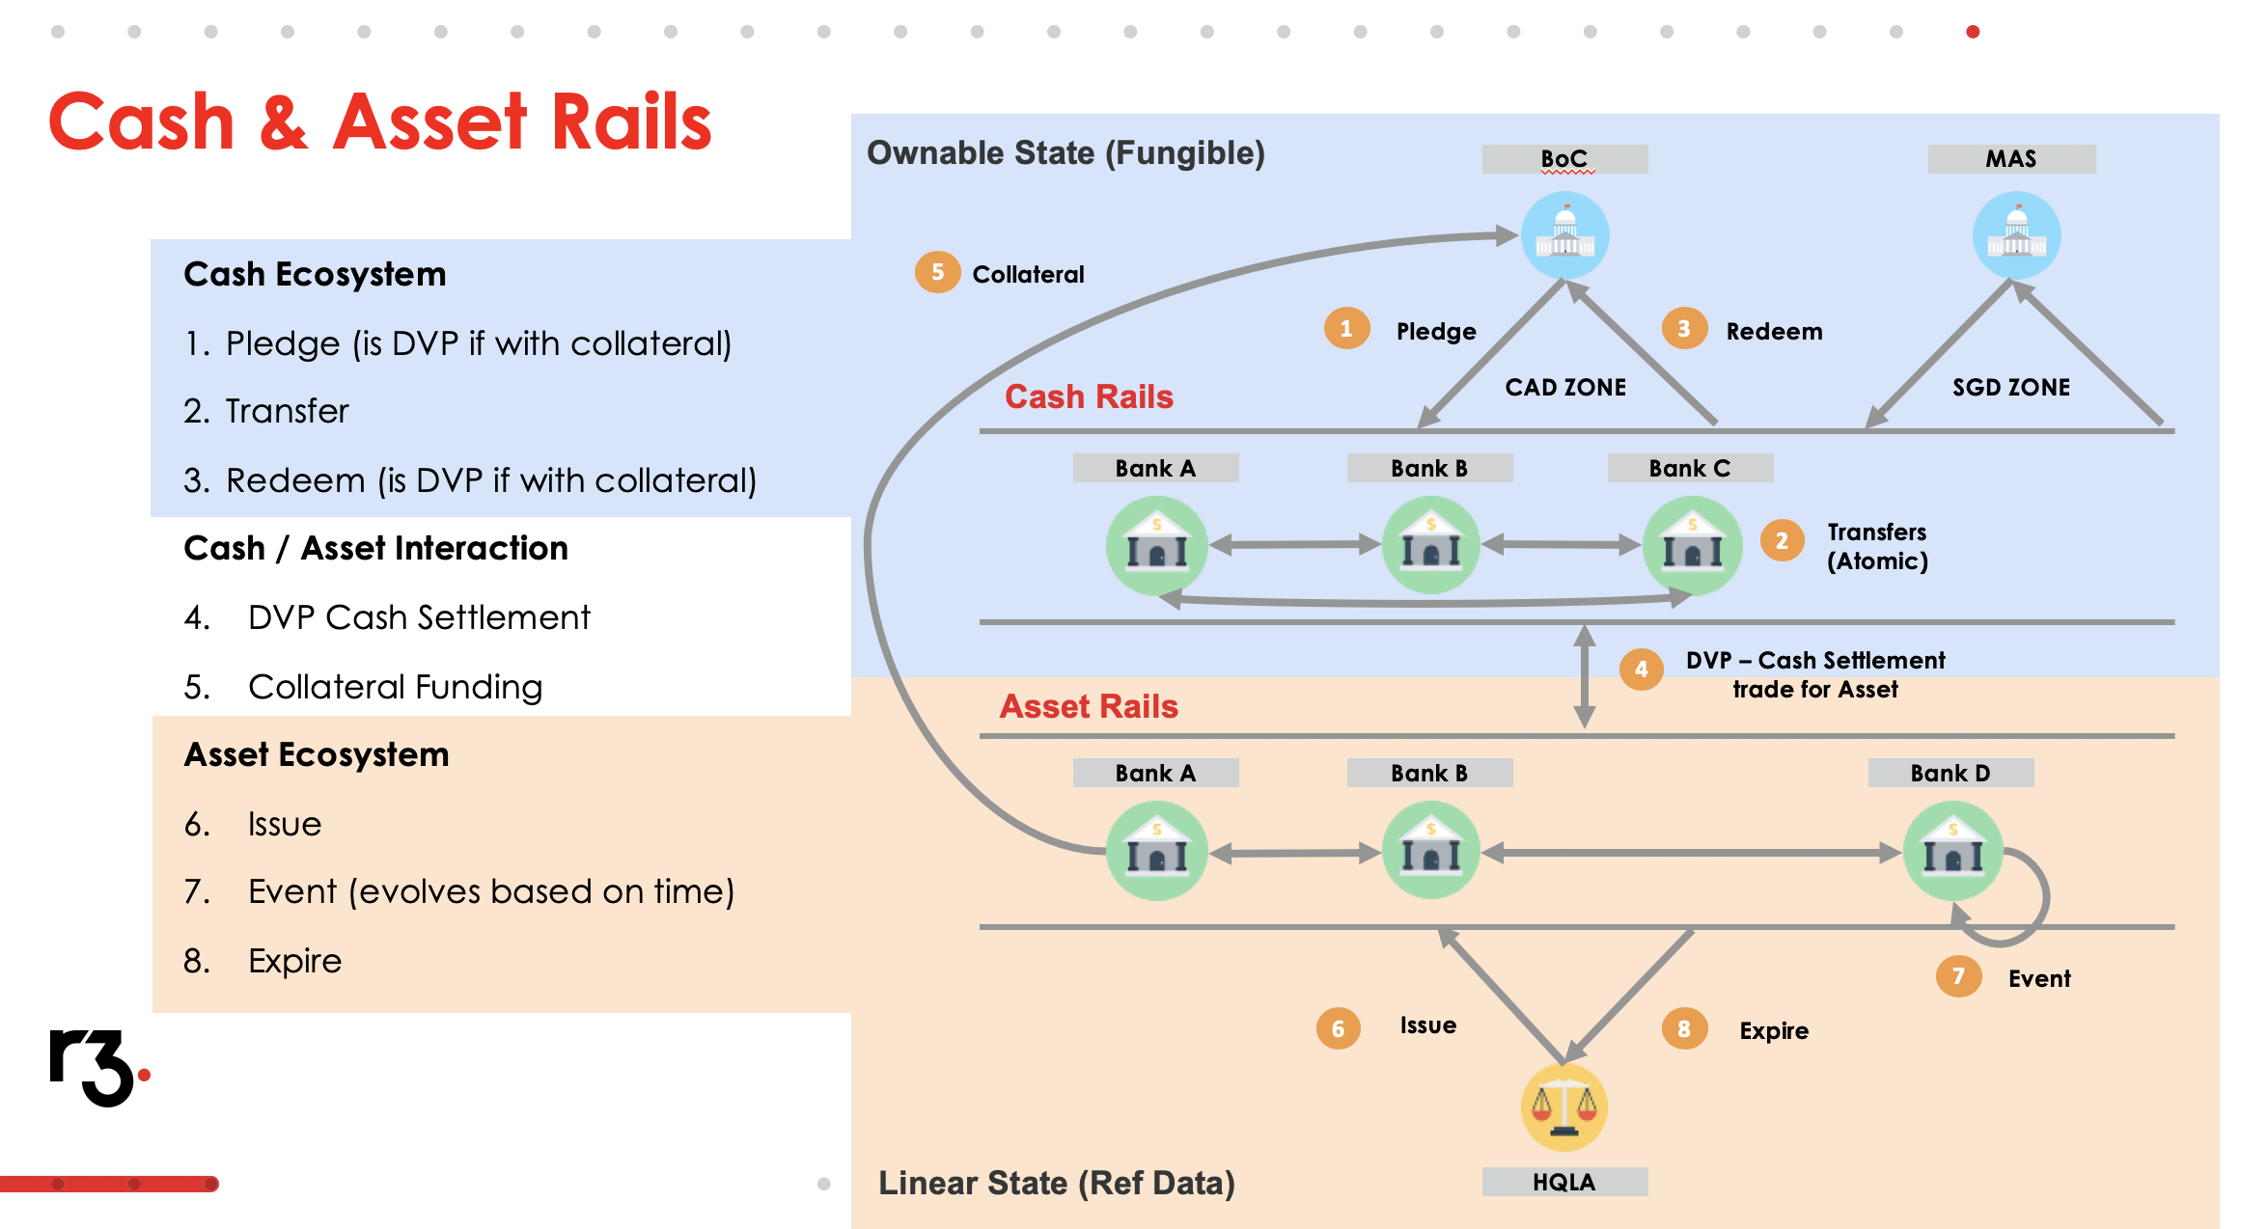
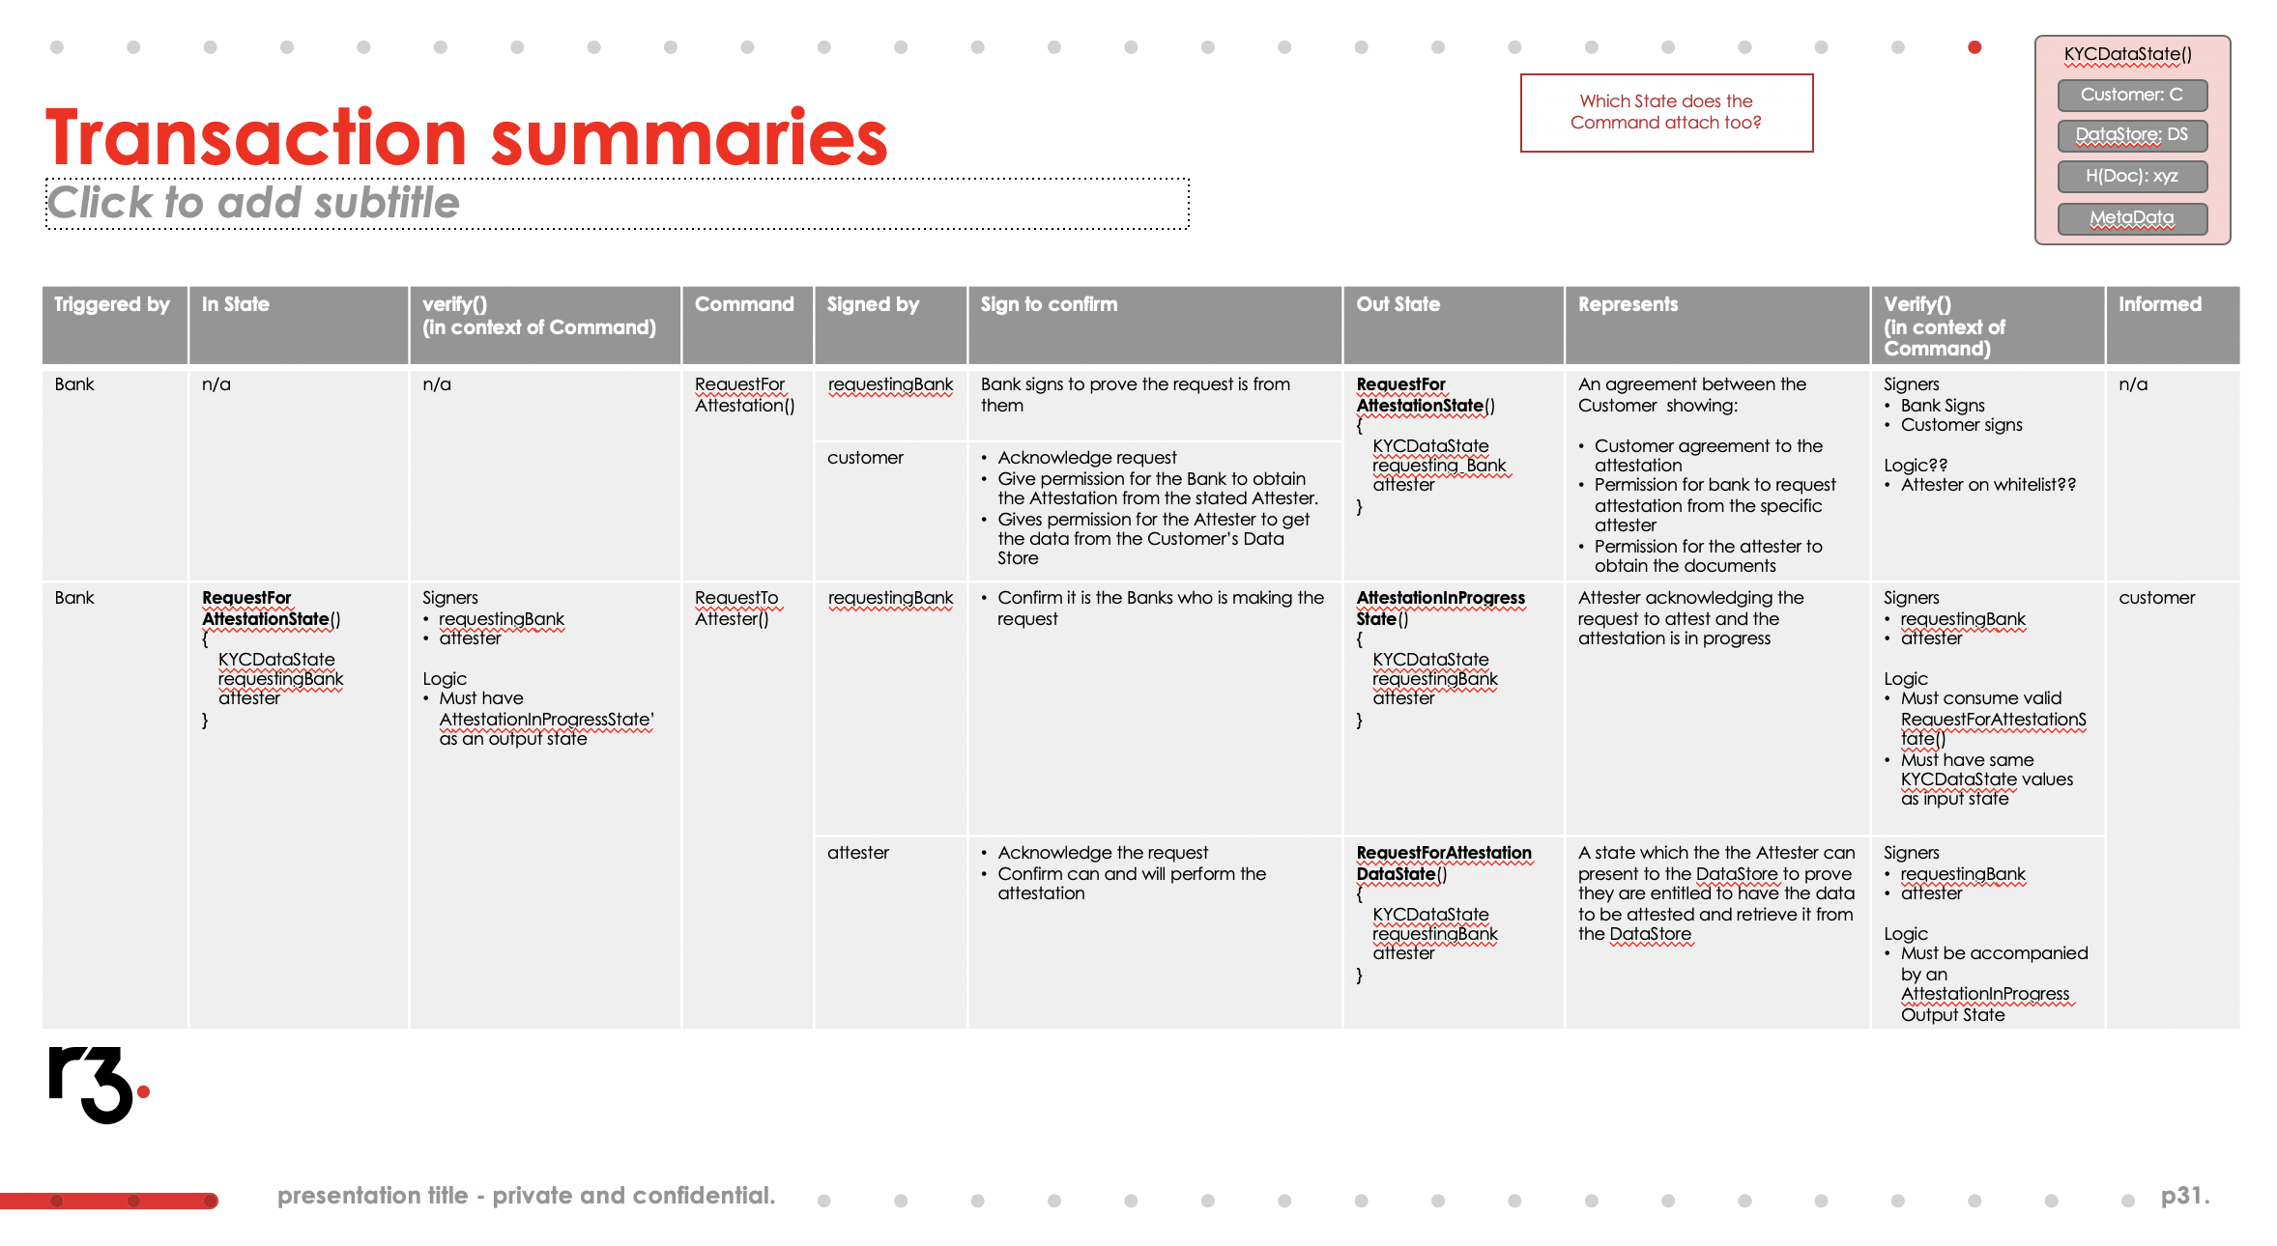
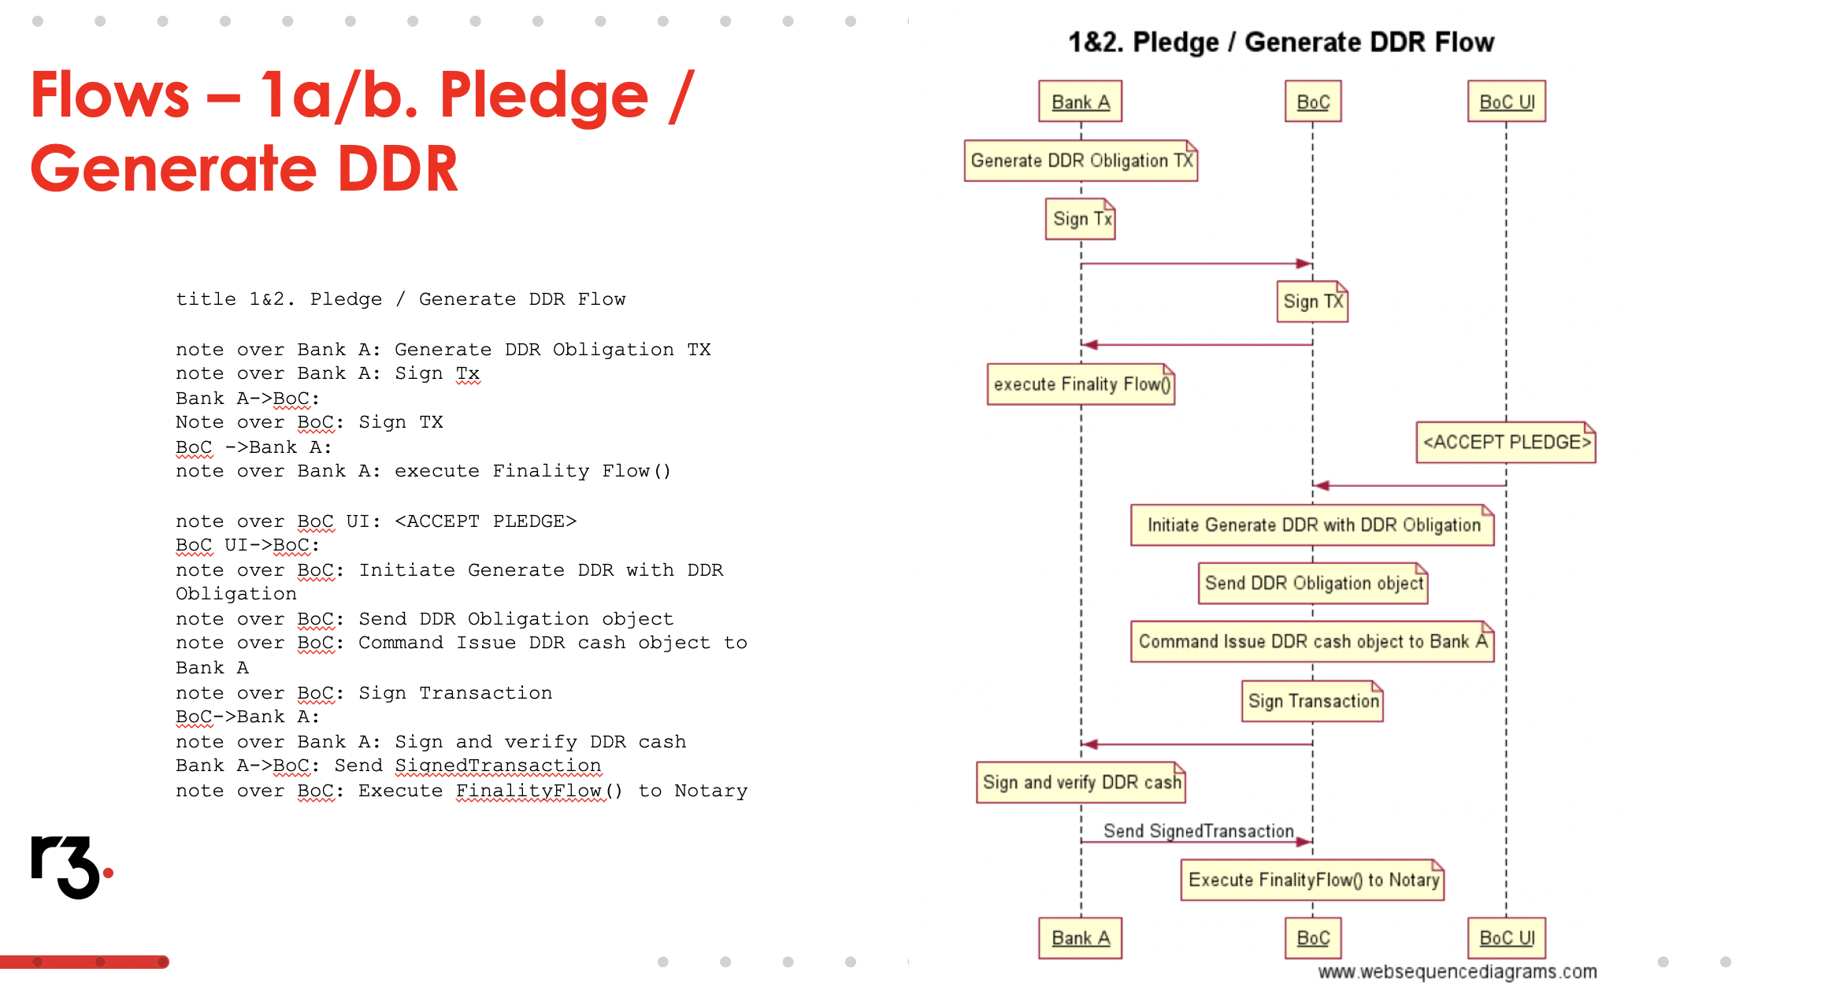
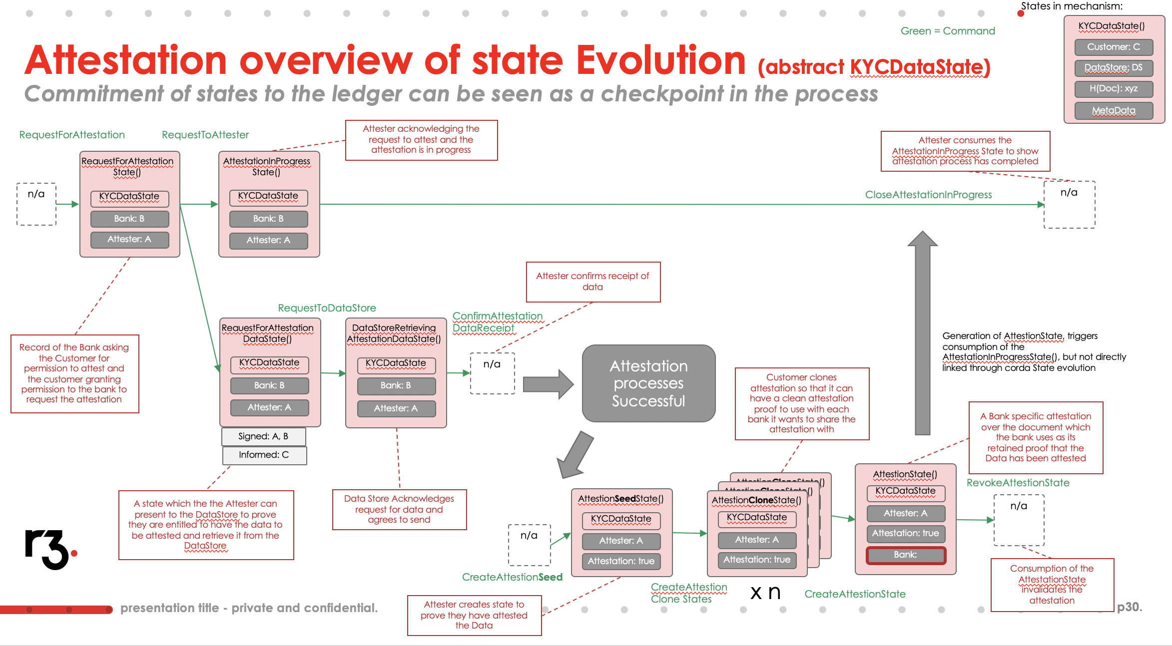
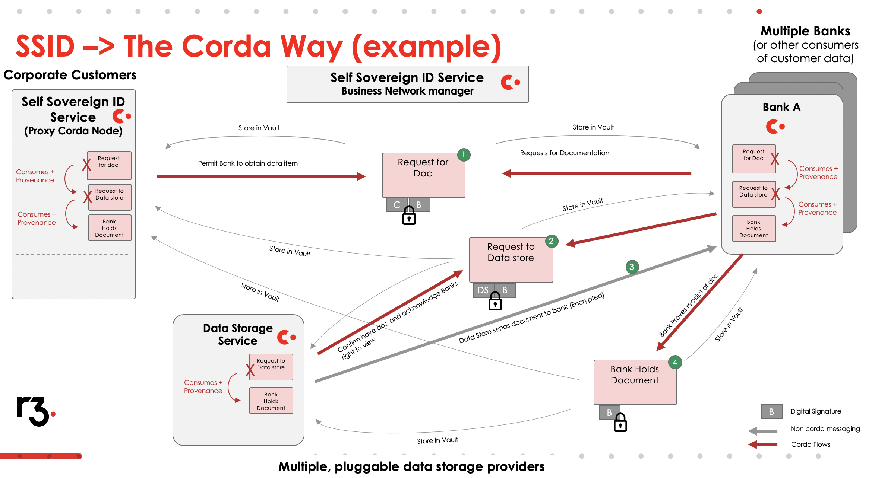
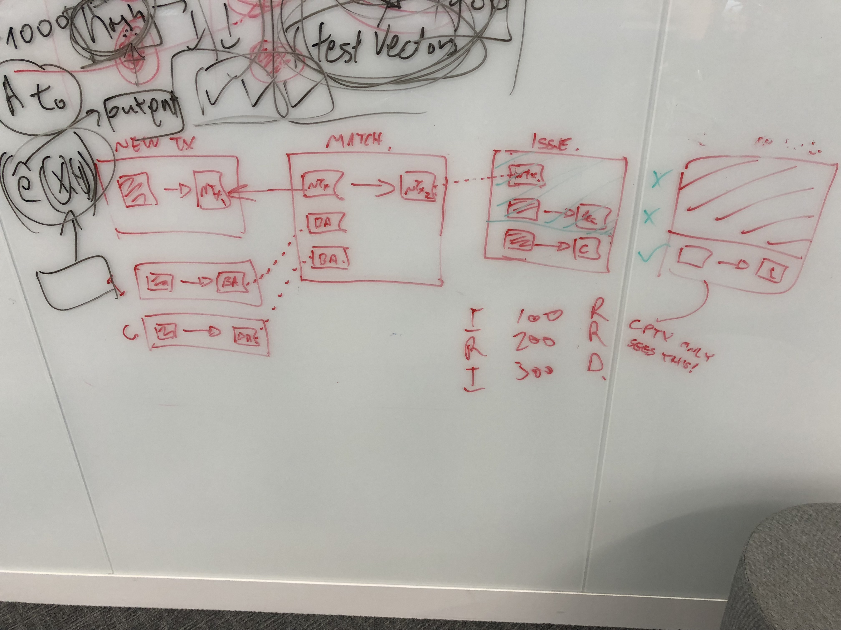
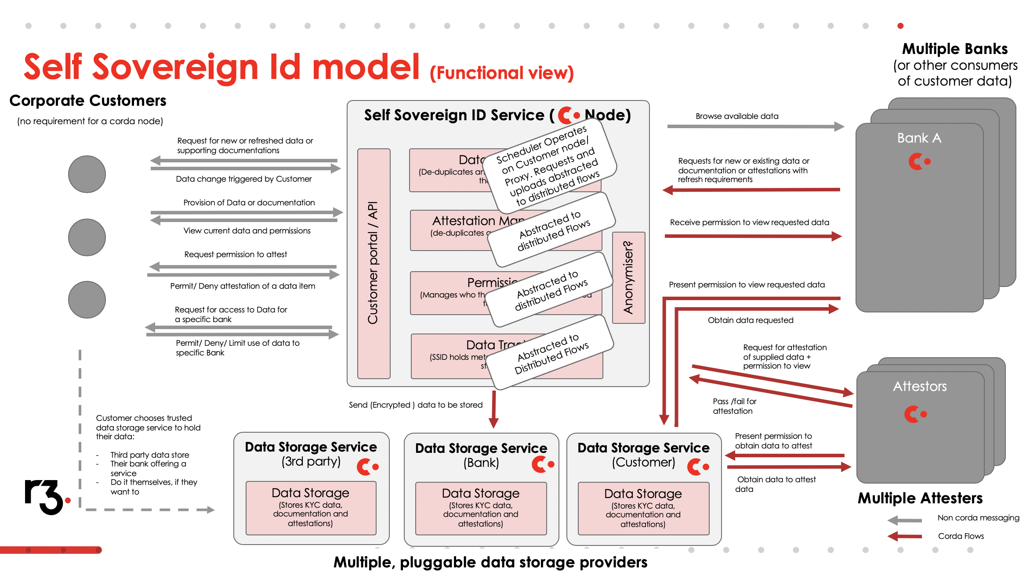
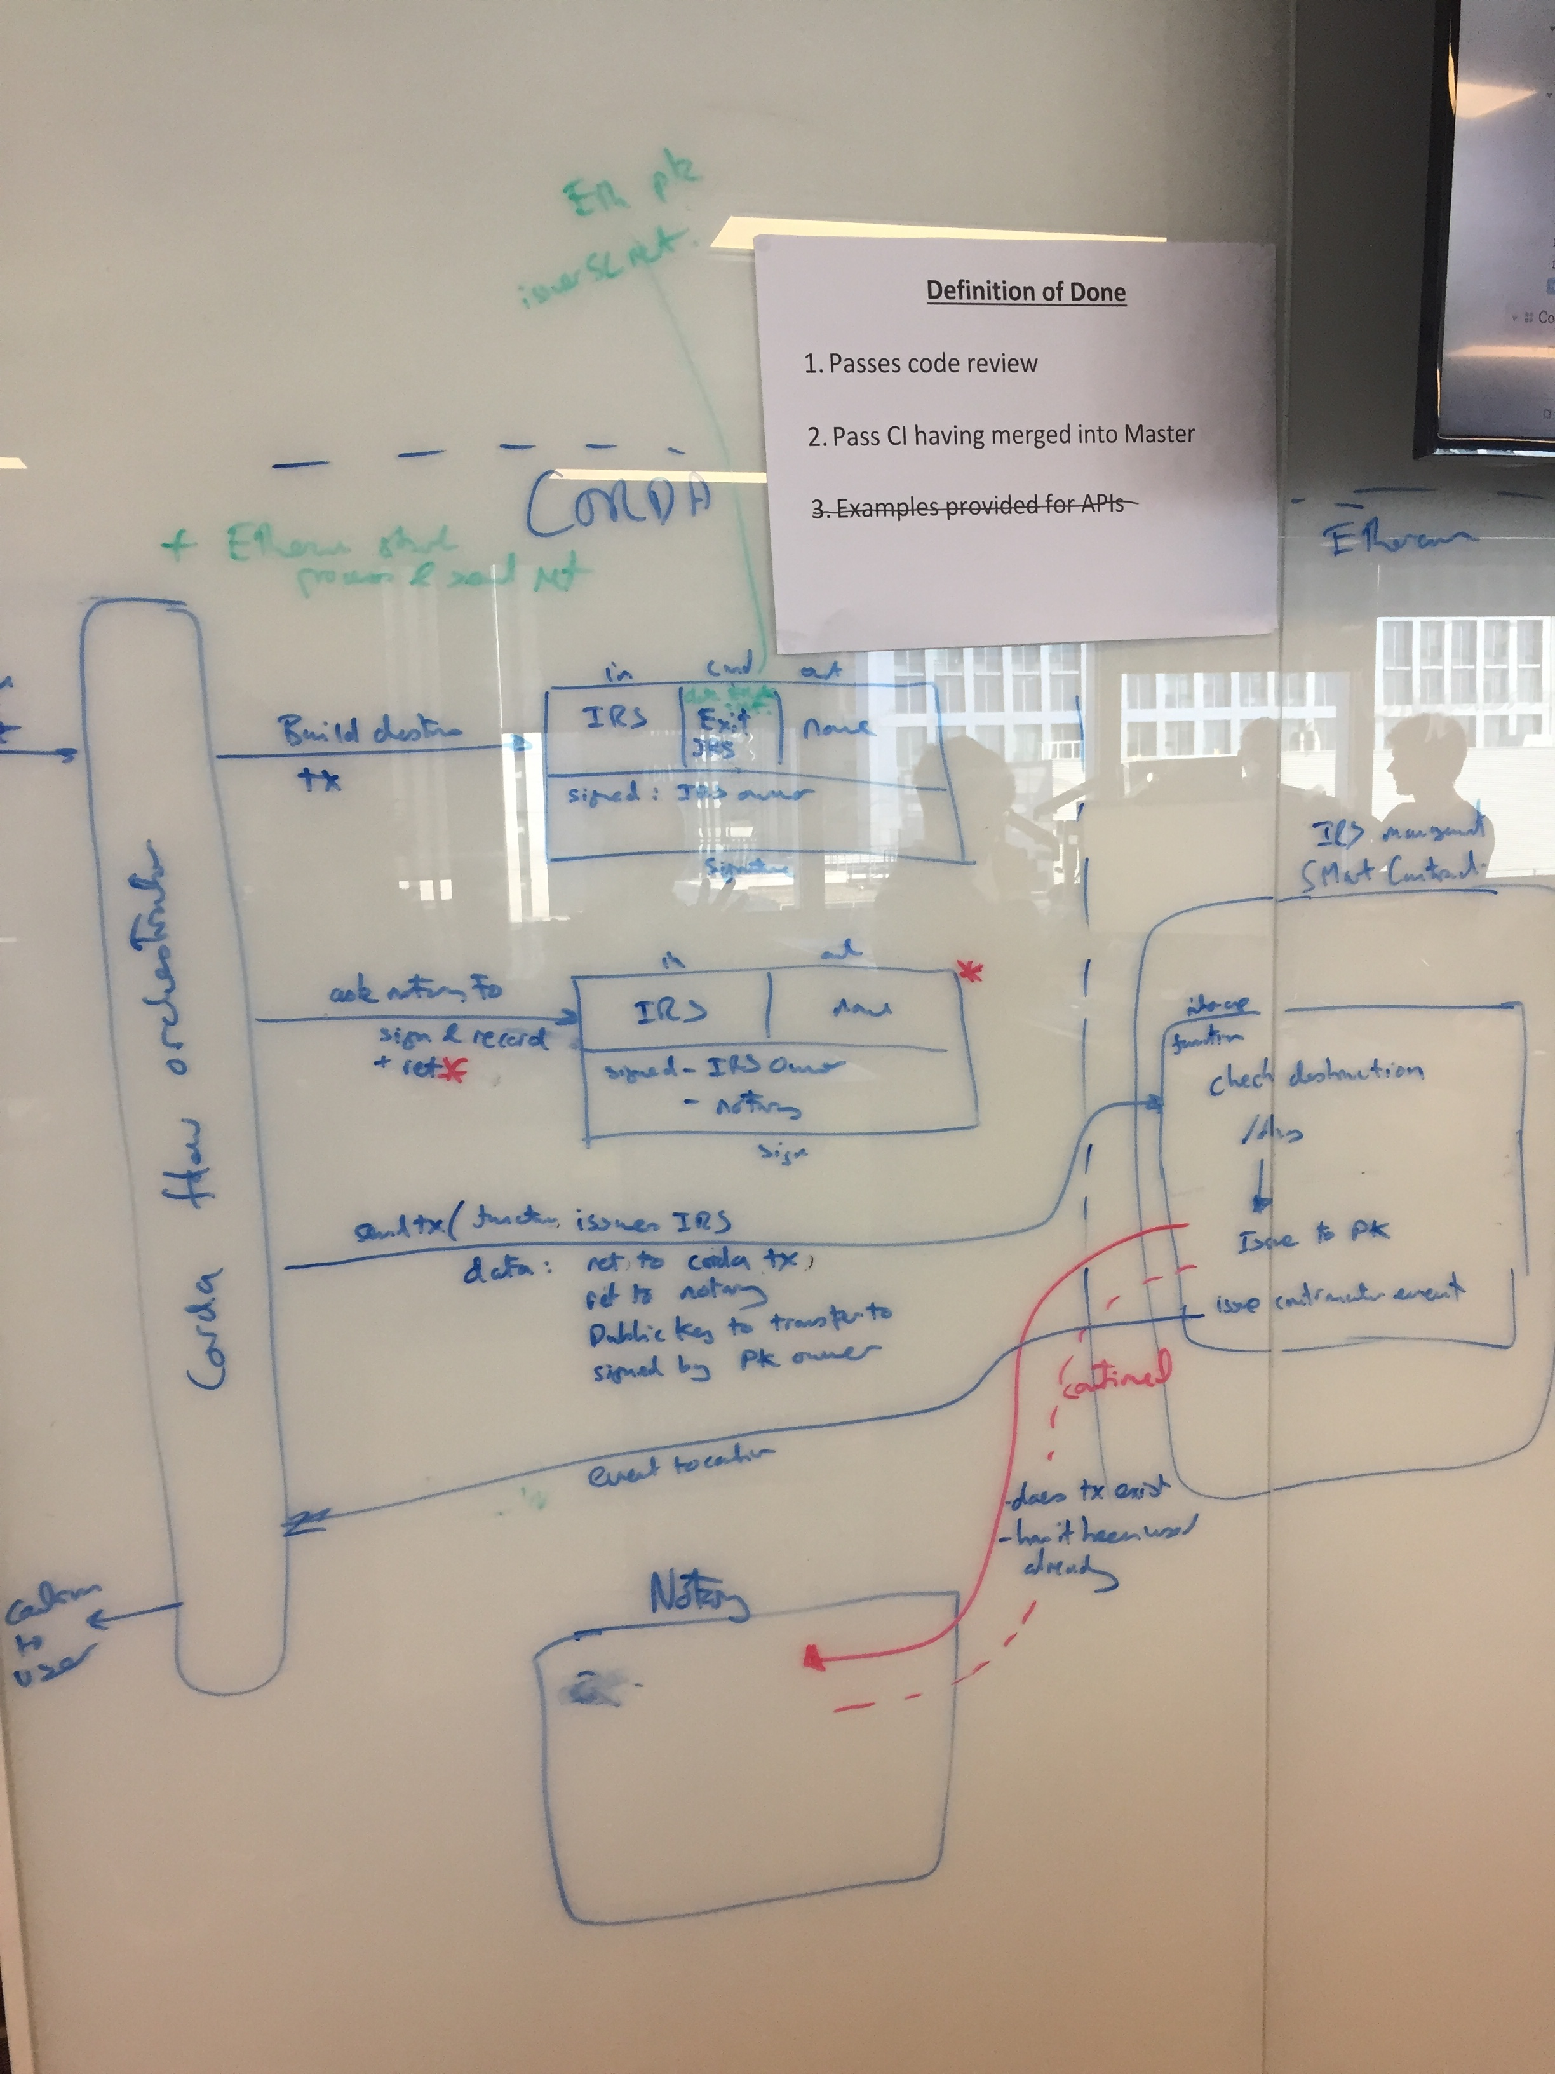
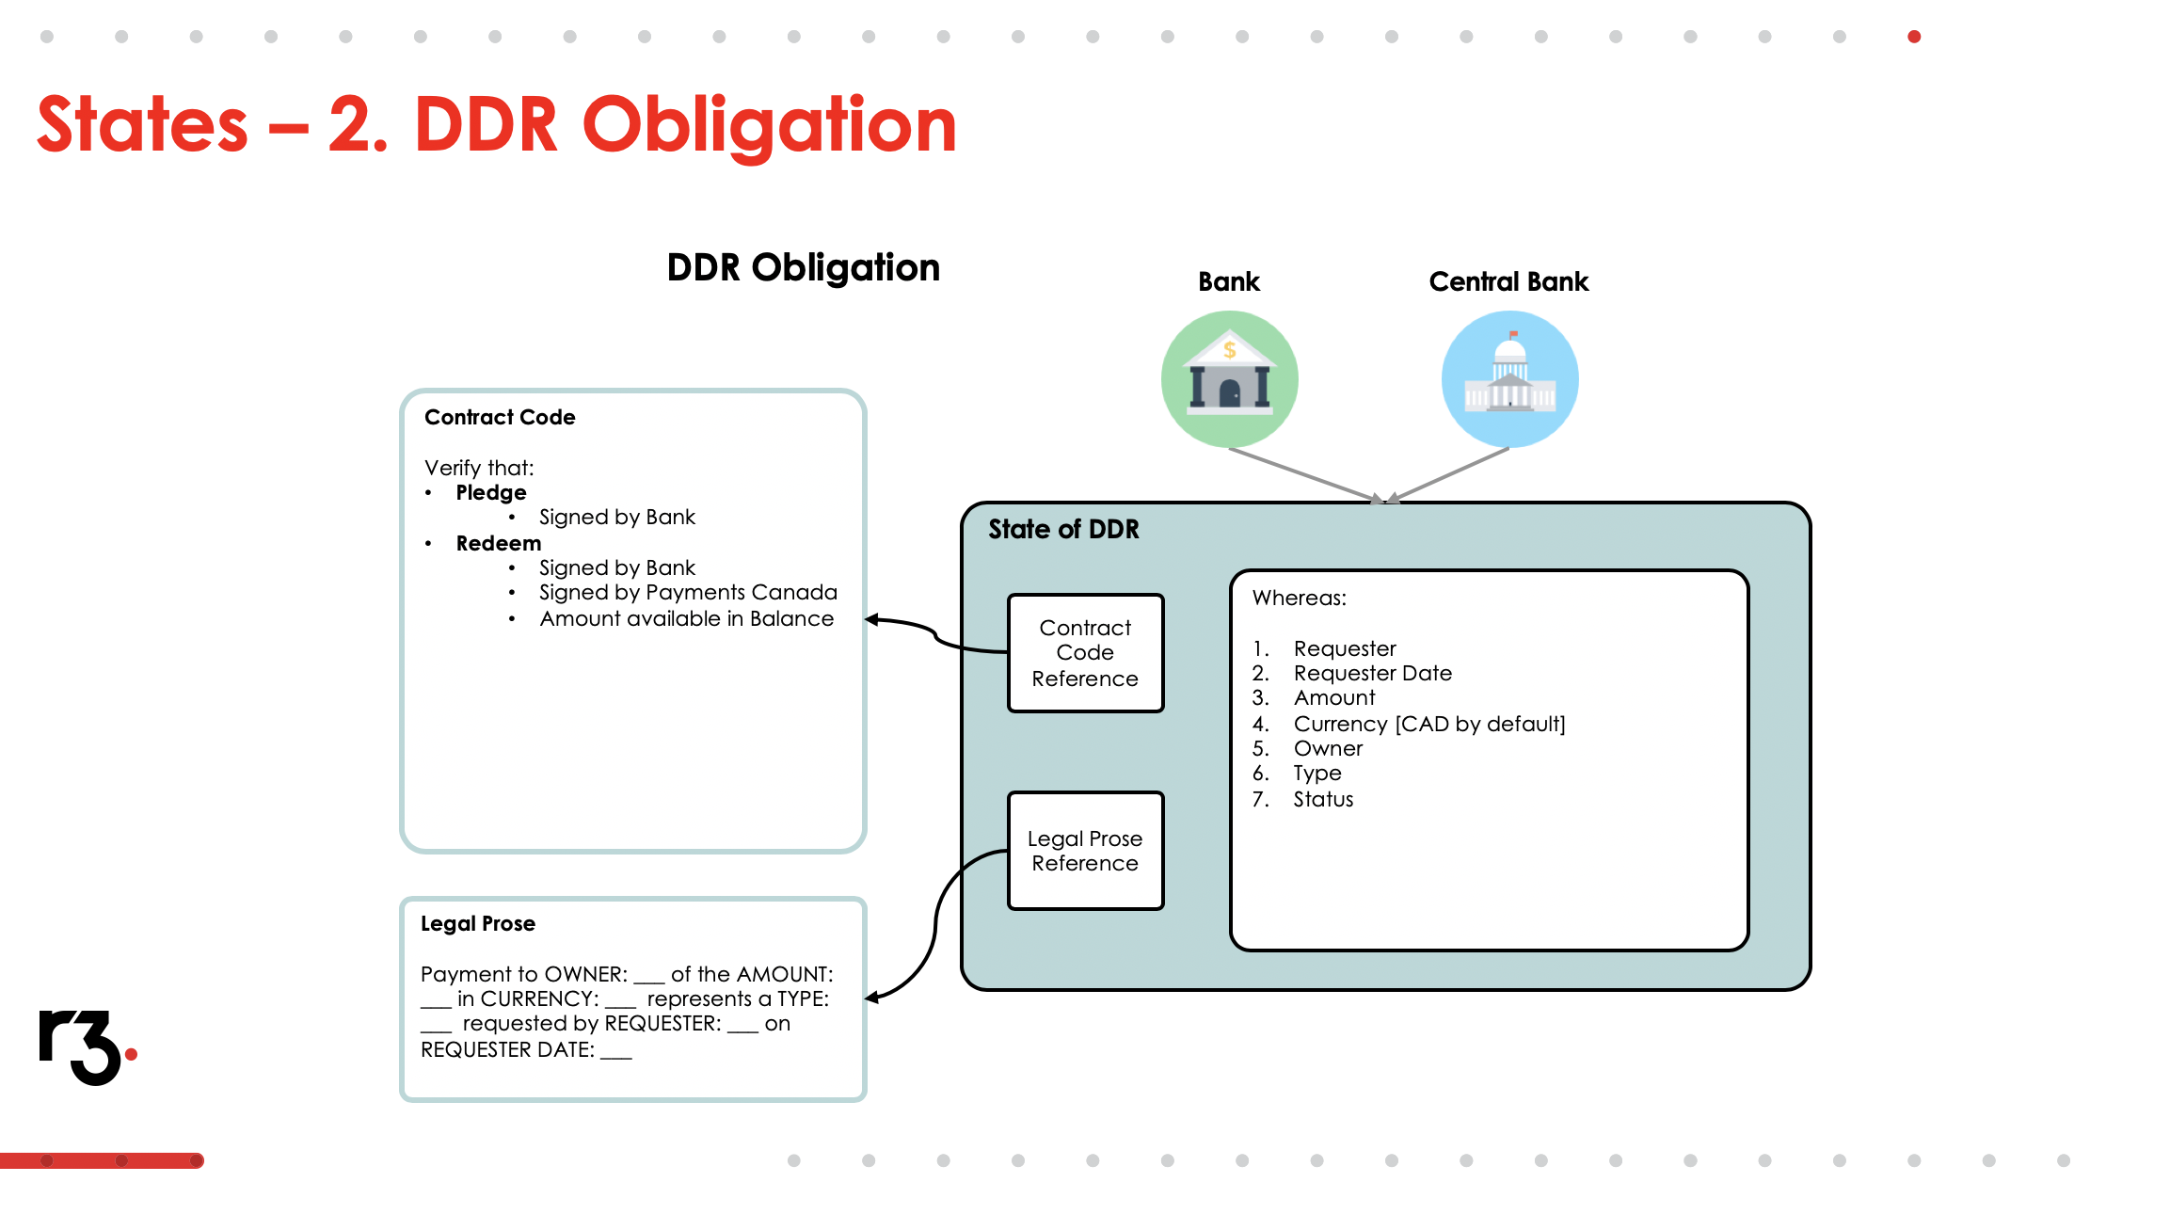
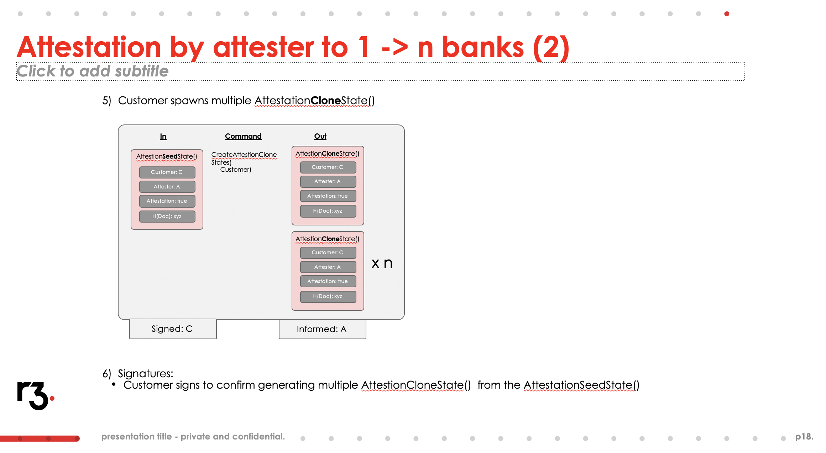
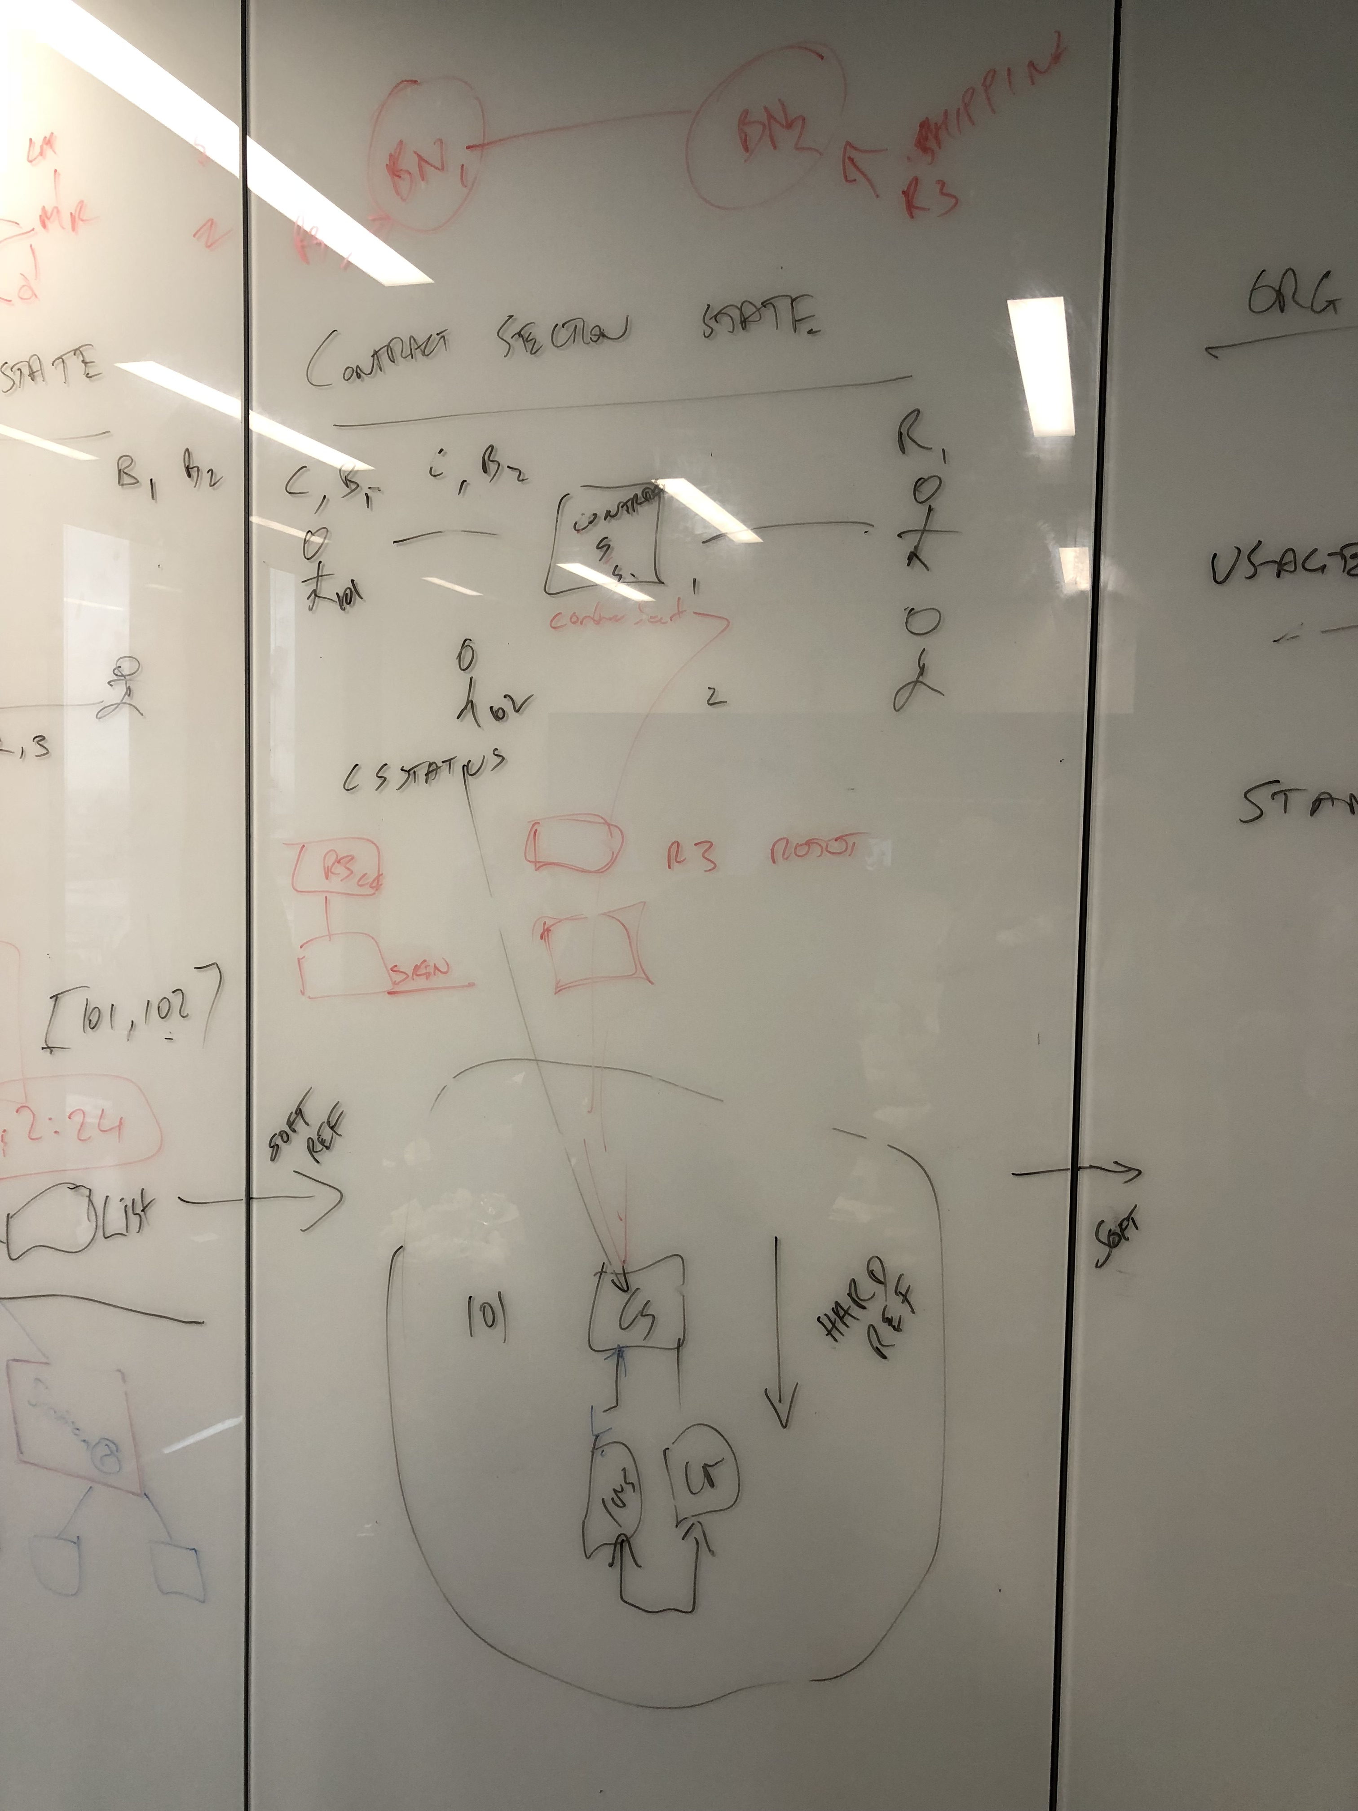
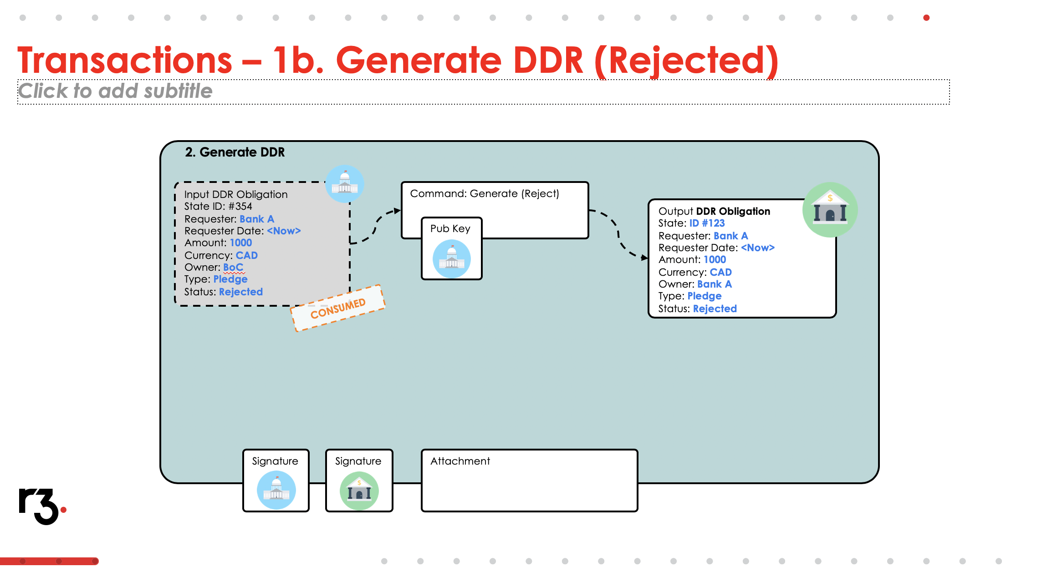
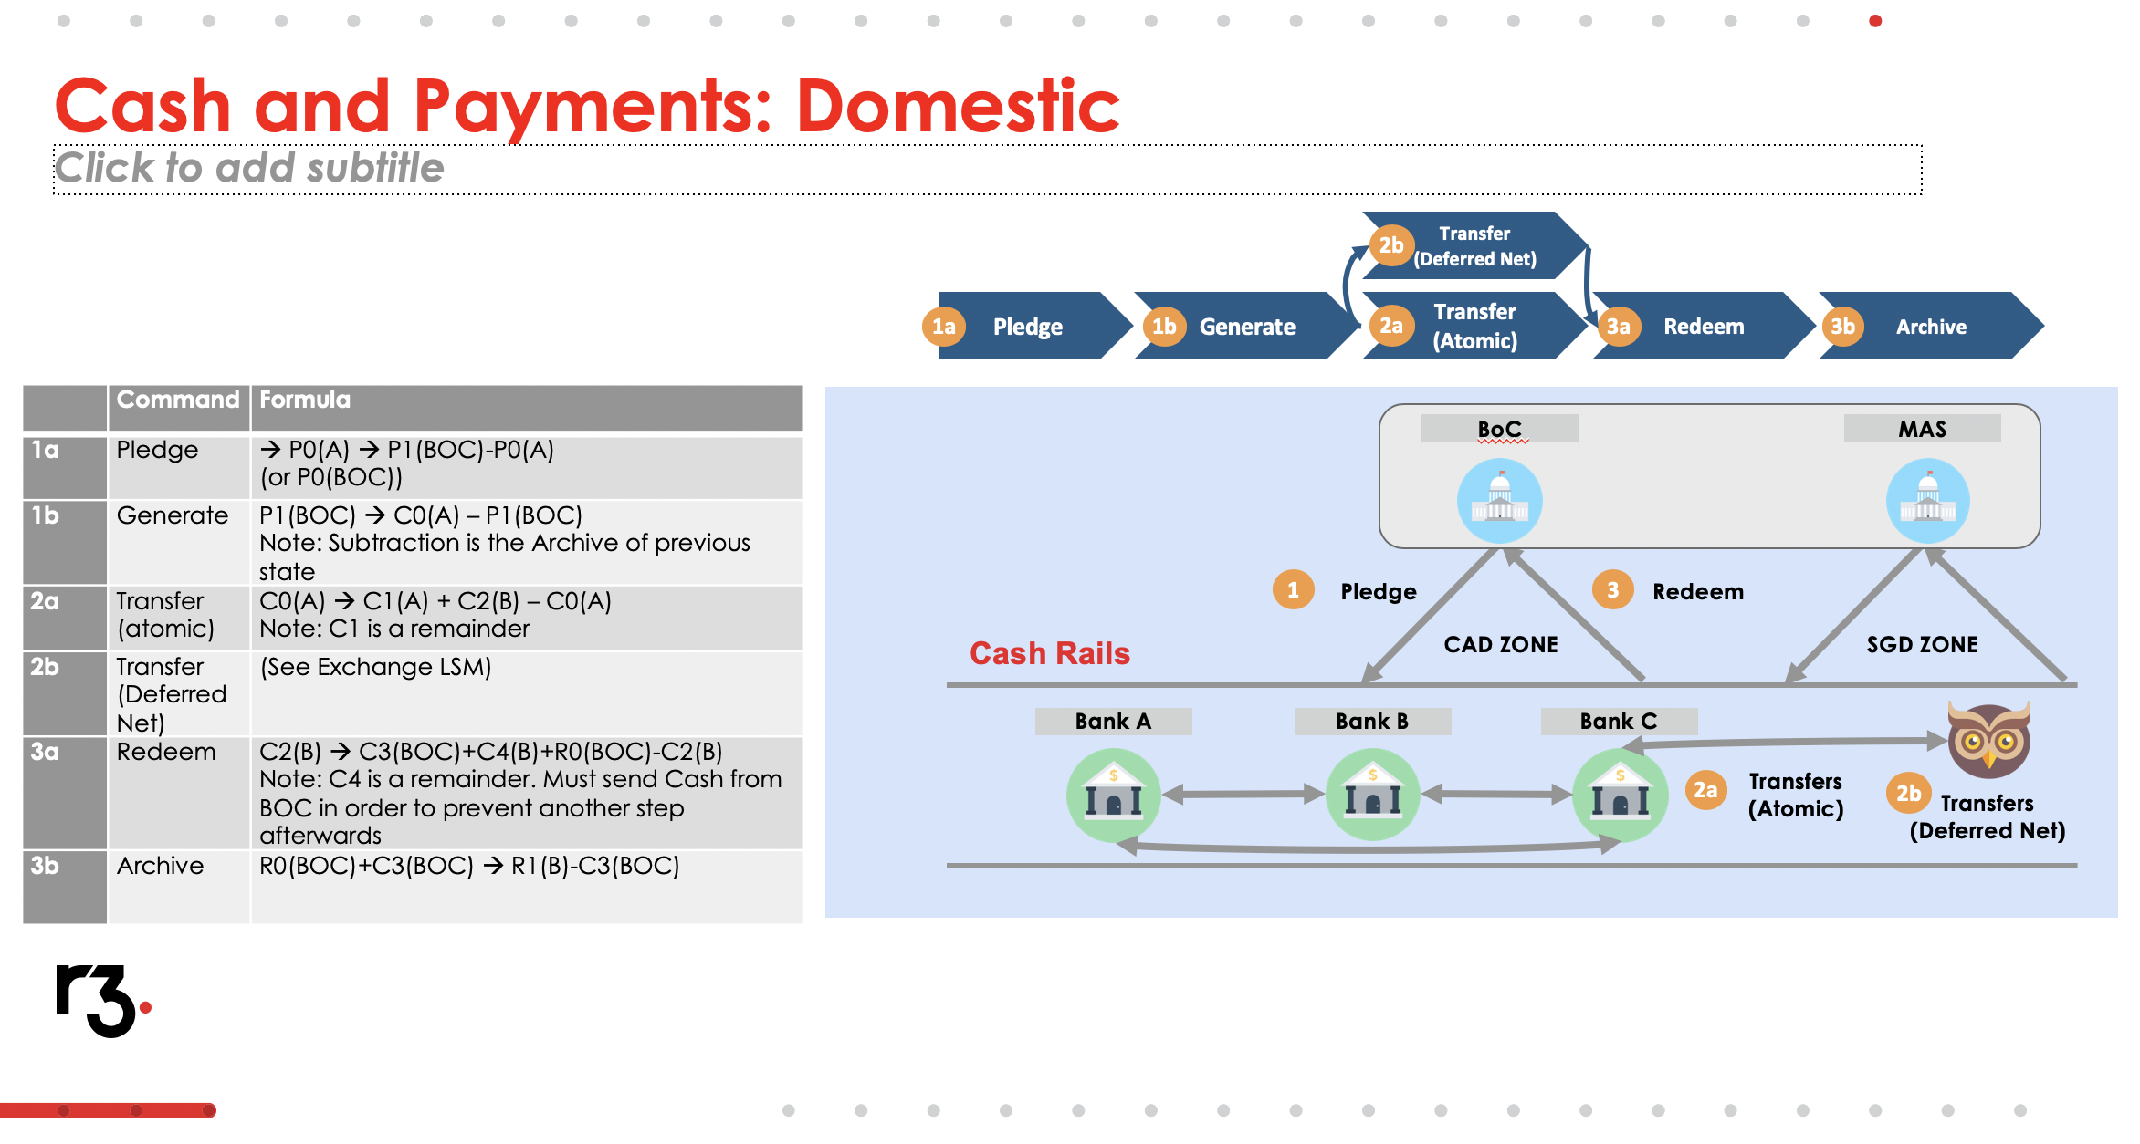
How to represent CorDapp design?

Slide 4

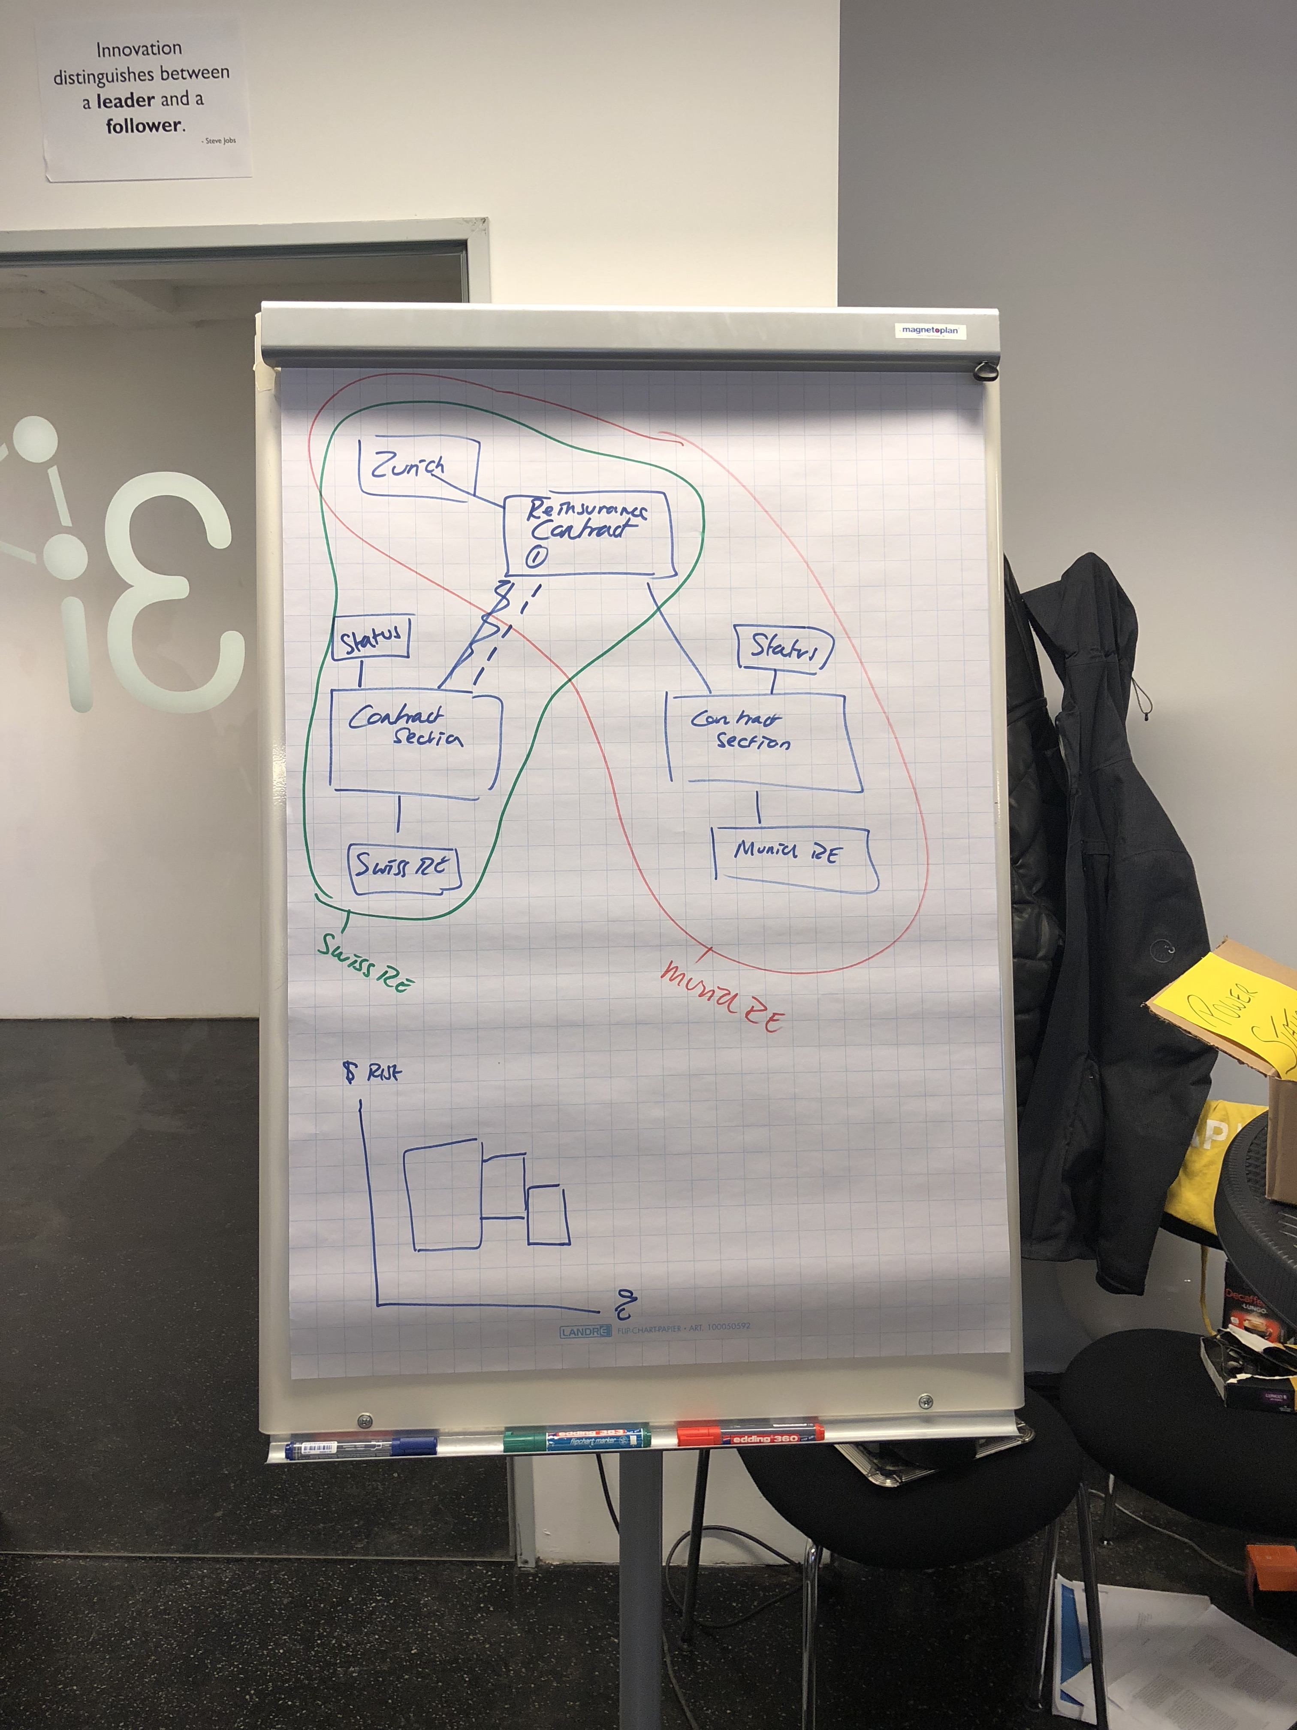

(Semi) Real Client example
WYSINWIS
I see.. So the data is all in the same Corda state
I see.. So the data is split across multiple Corda states
I have no Idea what that box is meant to be
What’s for lunch

Slide 5

The problem
VS
Working out the idea
Working out how to represent the idea

Slide 6
Conclusion…
We need a standardised way to represent and reason about non-trivial CorDapp designs, that encourages good CorDapp design
CorDapp Design Language
(Previously Corda Modelling Notation)

Slide 7
CorDapp Design Language - Objectives
Allow non-trivial CorDapp designs to be represented in an accurate, clear and concise way
Enable reasoning about key aspects of CorDapp design:
Shared data and state
Shared logic
Permissioning (via digital signatures)
Privacy (Visibility of data to different participants)
Encourage good design – distinguishes Ledger vs Orchestration Layer
Facilitate reusable Design Patterns
Degrade gracefully
Accurate design documentation – Not just Marketechture

Slide 8
Let do some examples
Represent a Smart Contract using State Machine View
Show a Smart Contract in action using Transaction Instance view and State Evolution View
Analyse Smart Contract privacy using Privacy Overlays
Introduce a few design patterns along the way

Slide 9
How to represent a Smart Contract
Smart Contracts in Corda are made up of
ContractState (Data), and
Contract (Rule book)
You can consider the Smart Contract behaviour as a Finite State Machine
Think washing machine
Example: An agreement for a Seller to sell goods to a buyer for an agreed price

Slide 10
Lets use the…
State Machine View
Or ‘drawing a Smart Contract’

Slide 11
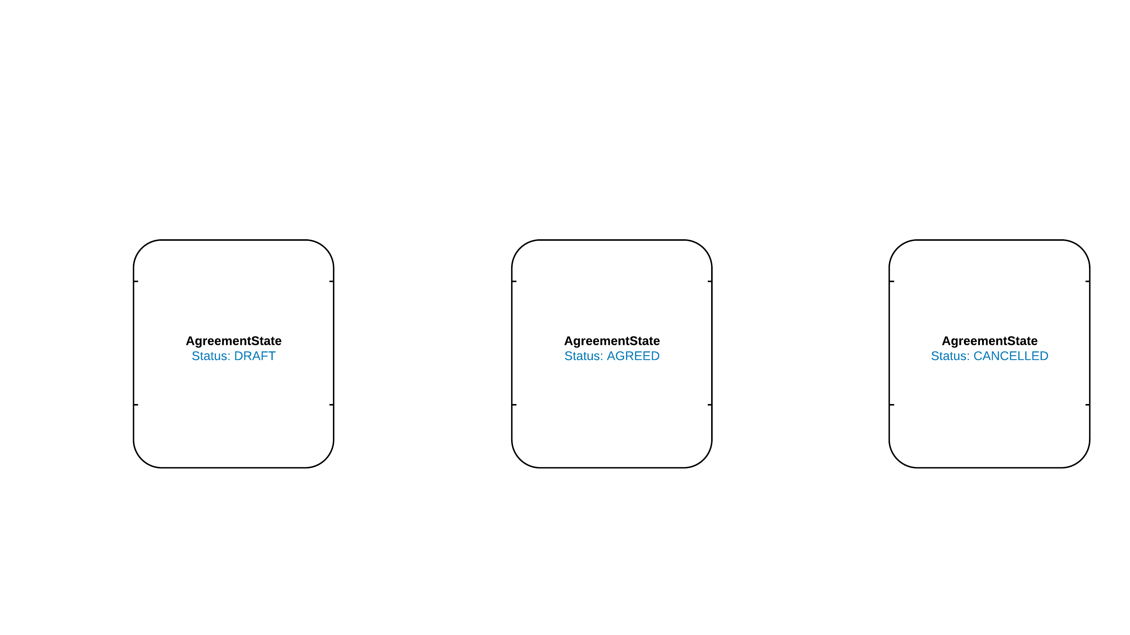

Slide 12
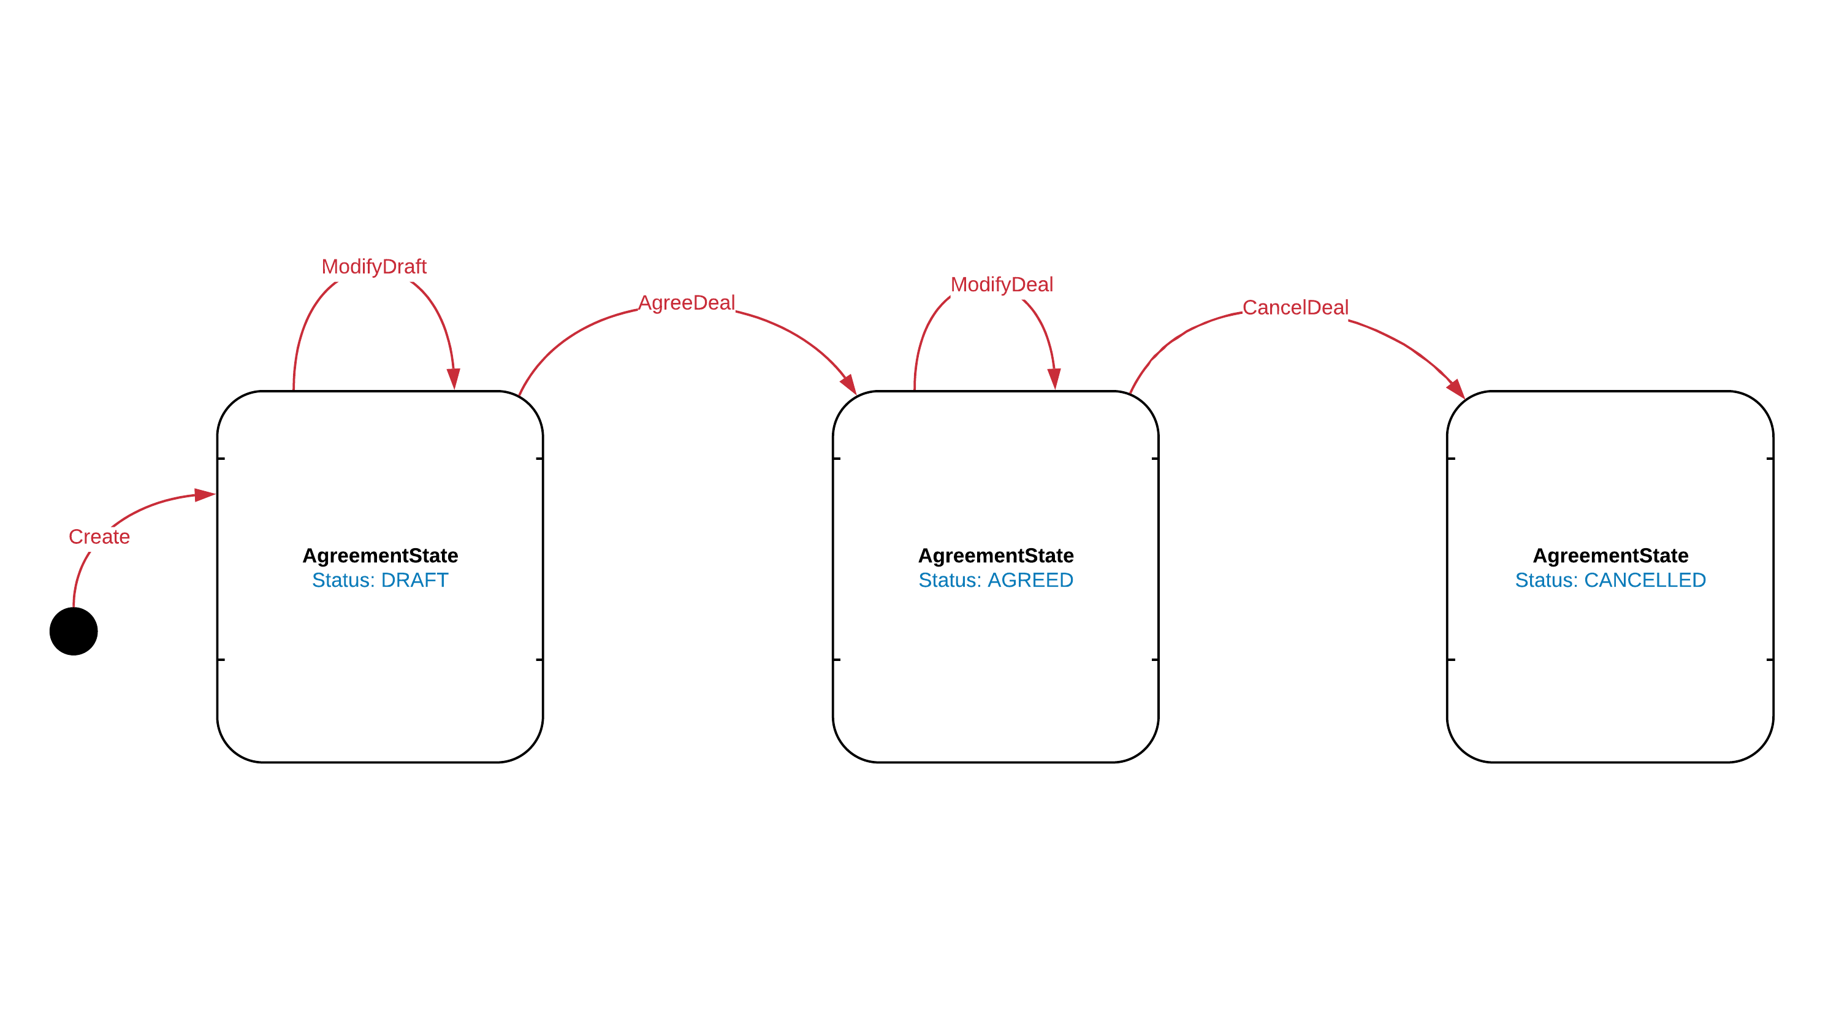

Slide 13
Constraints -> Verify()

Slide 14
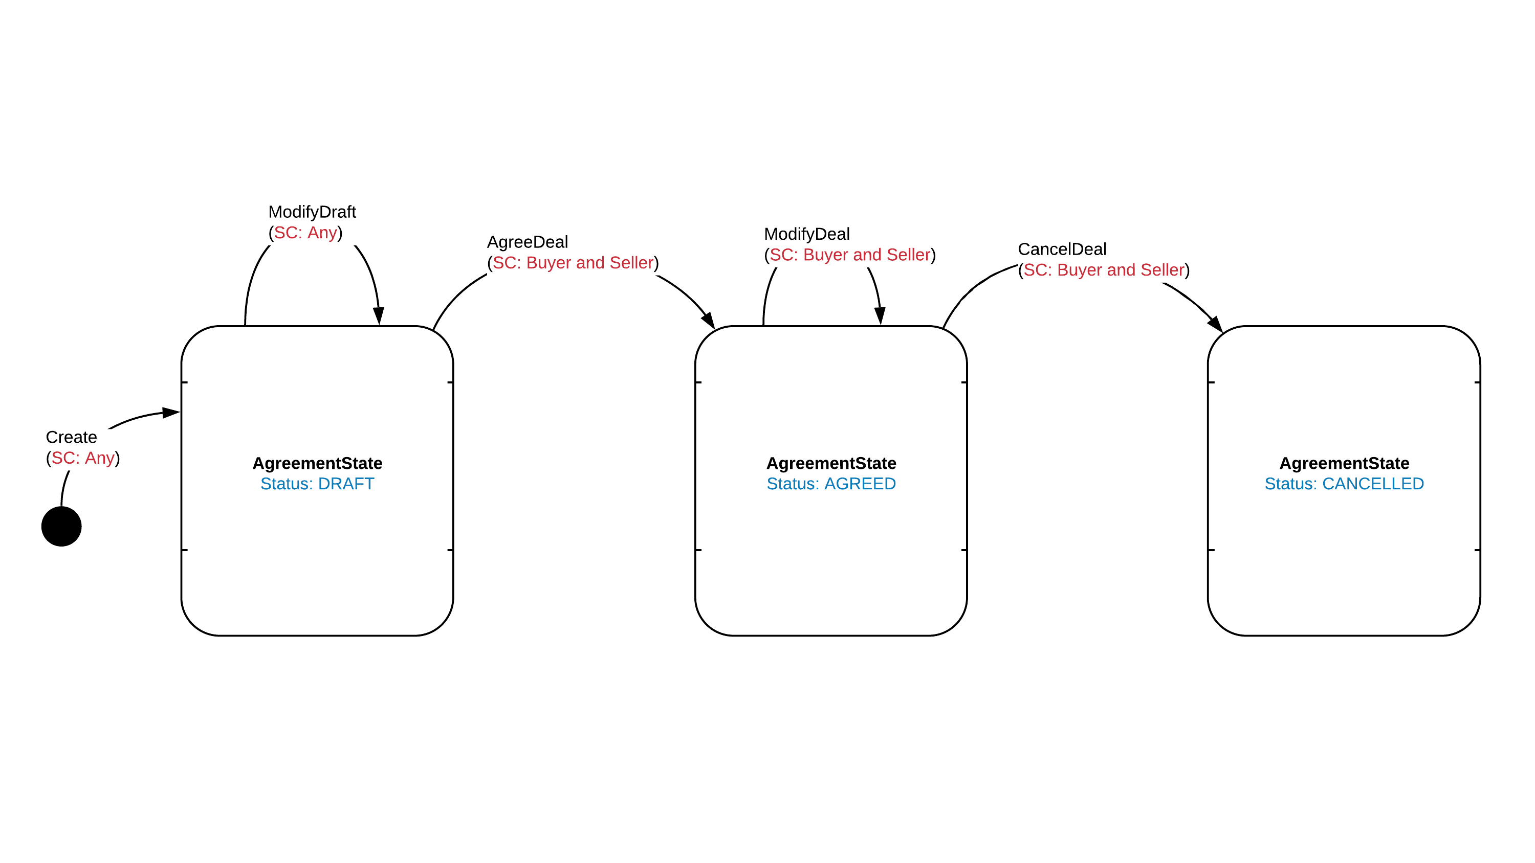

Slide 15
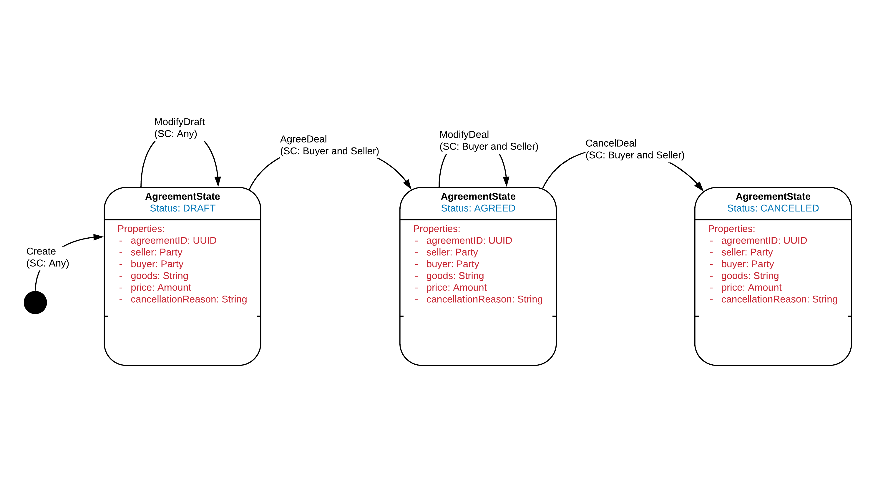

Slide 16
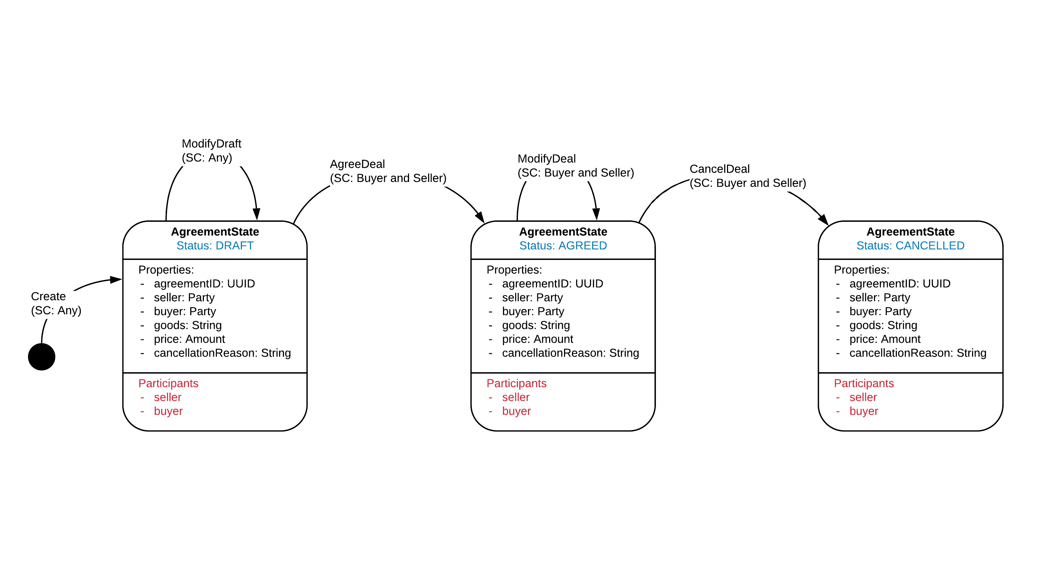

Slide 17
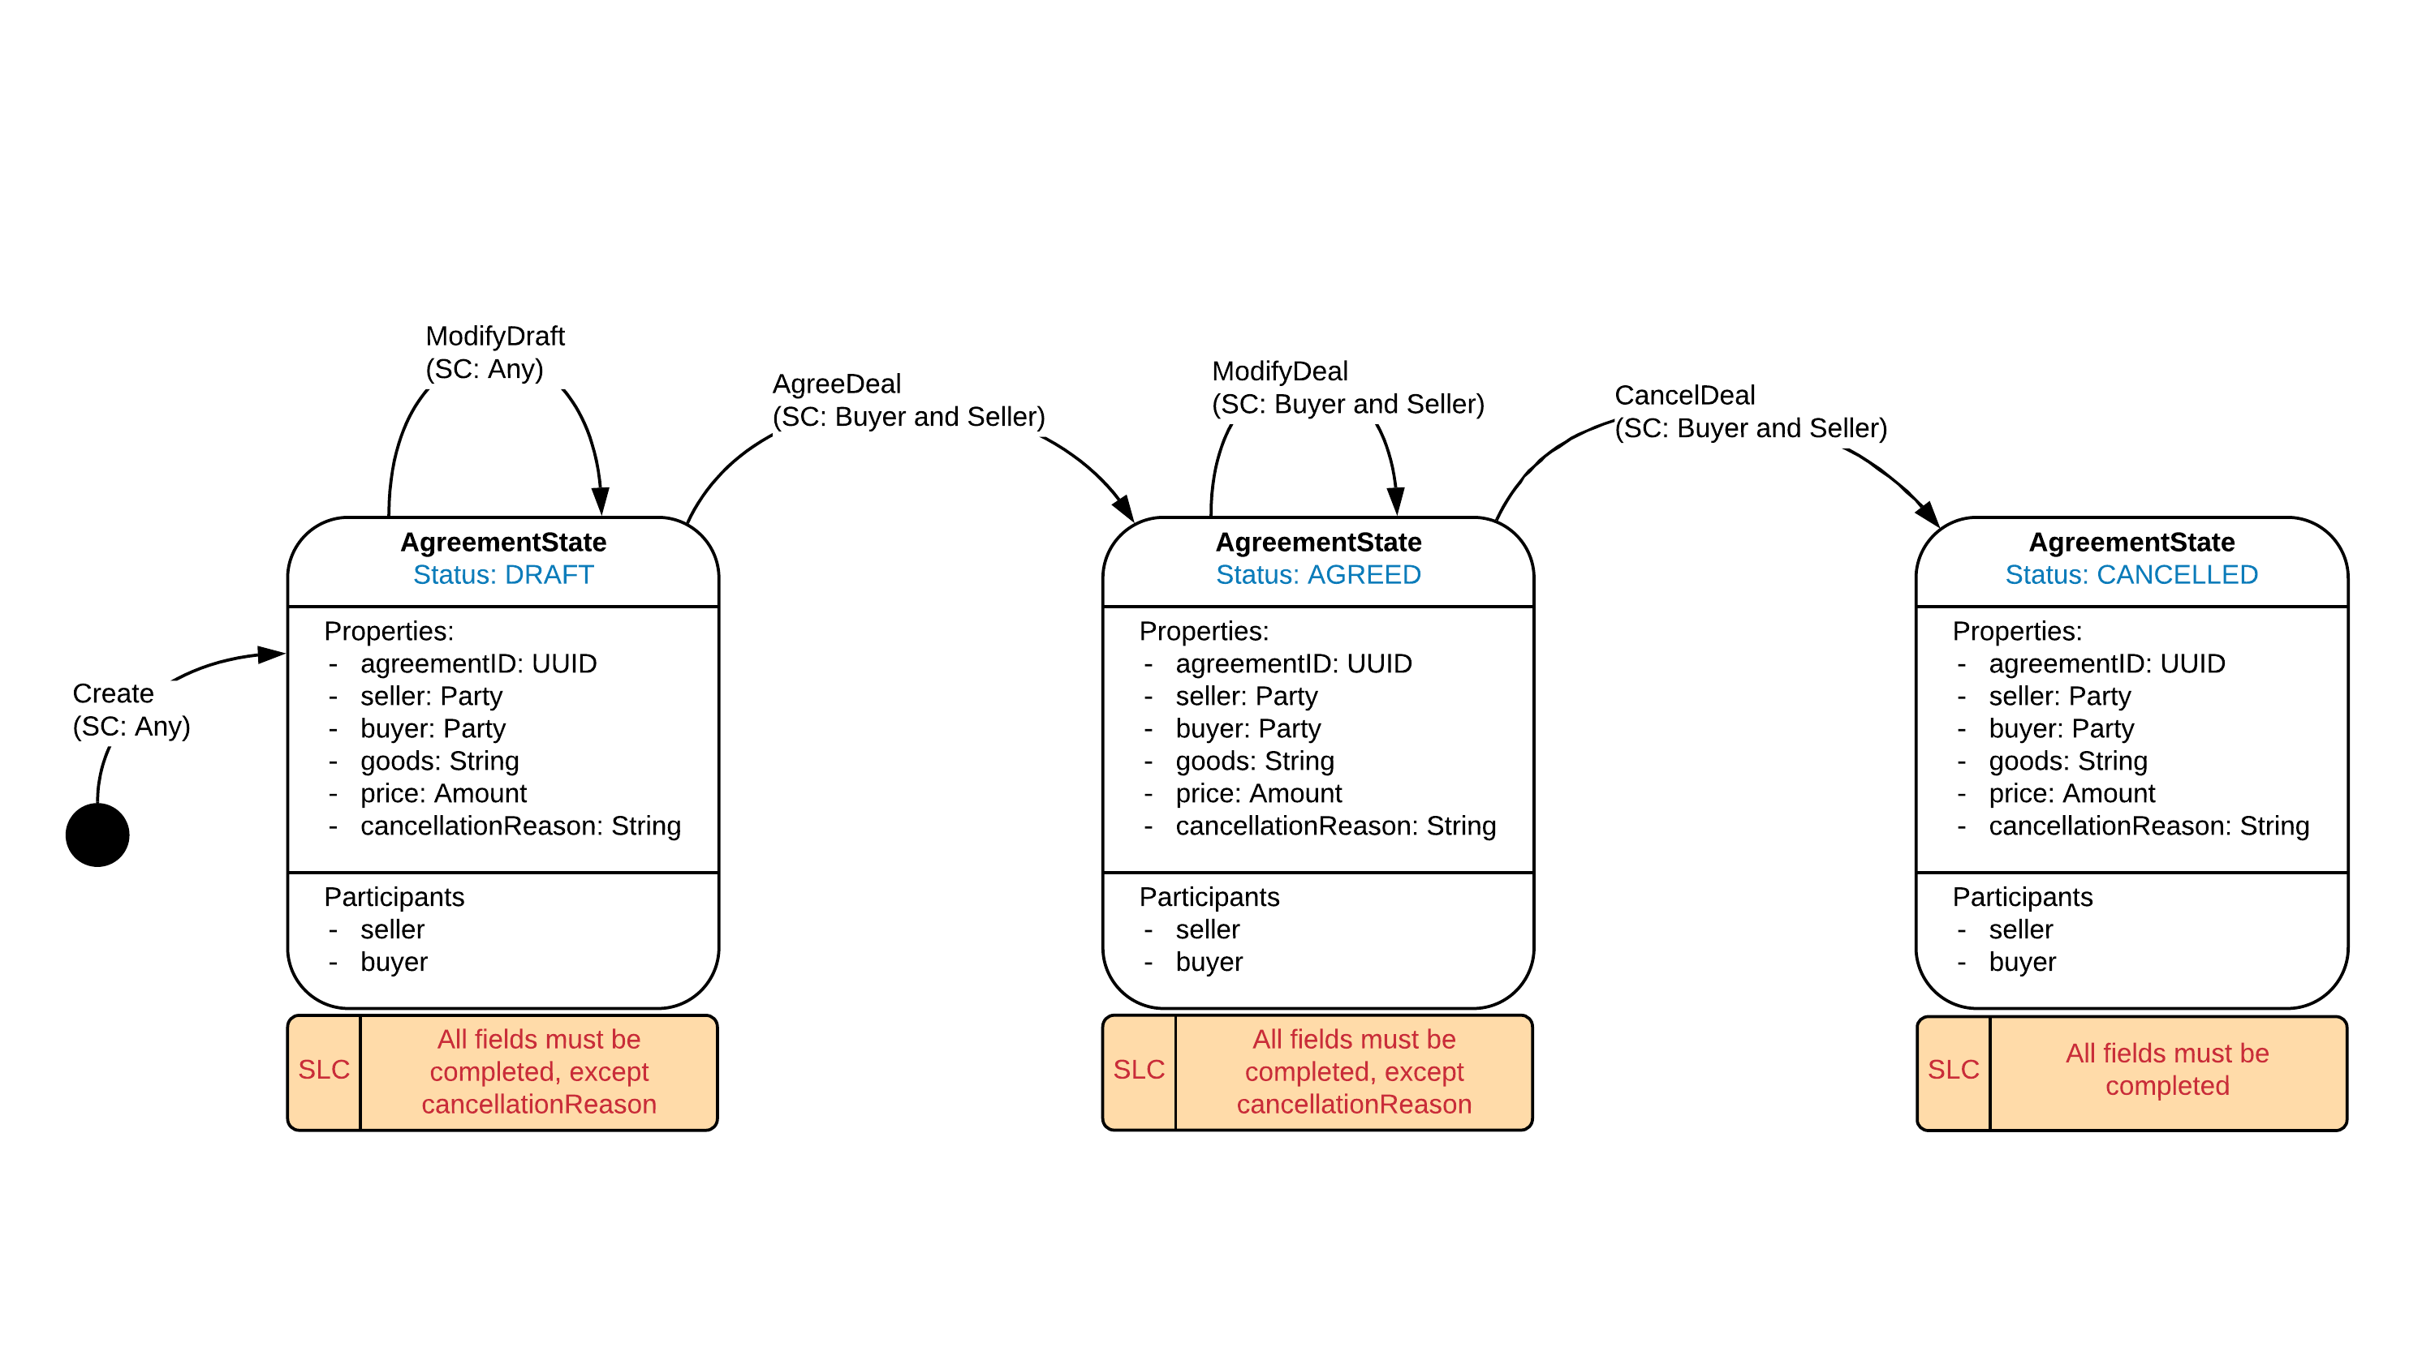

Slide 18
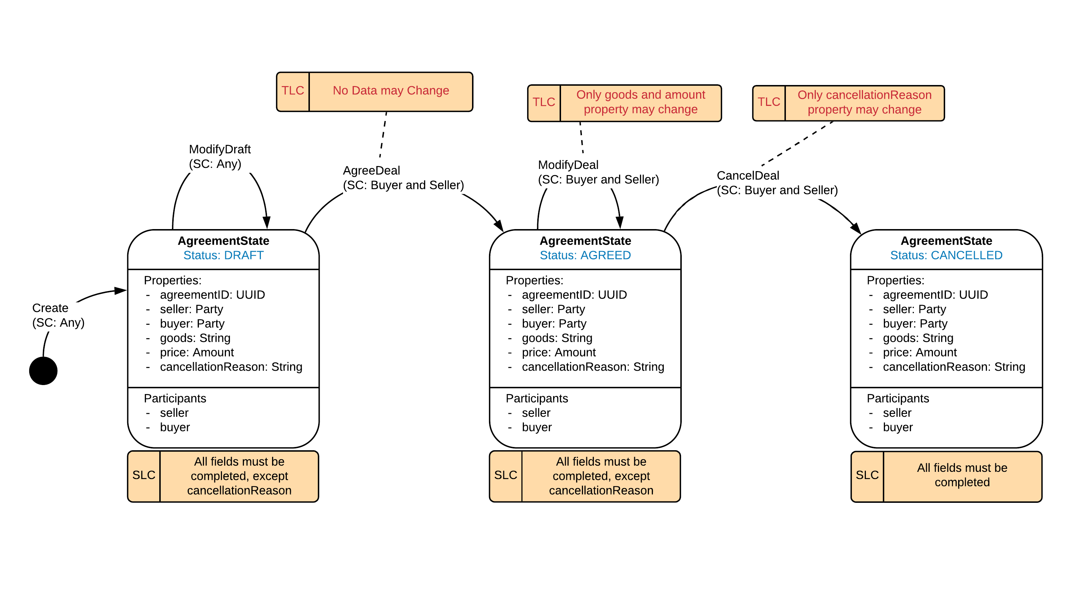

Slide 19
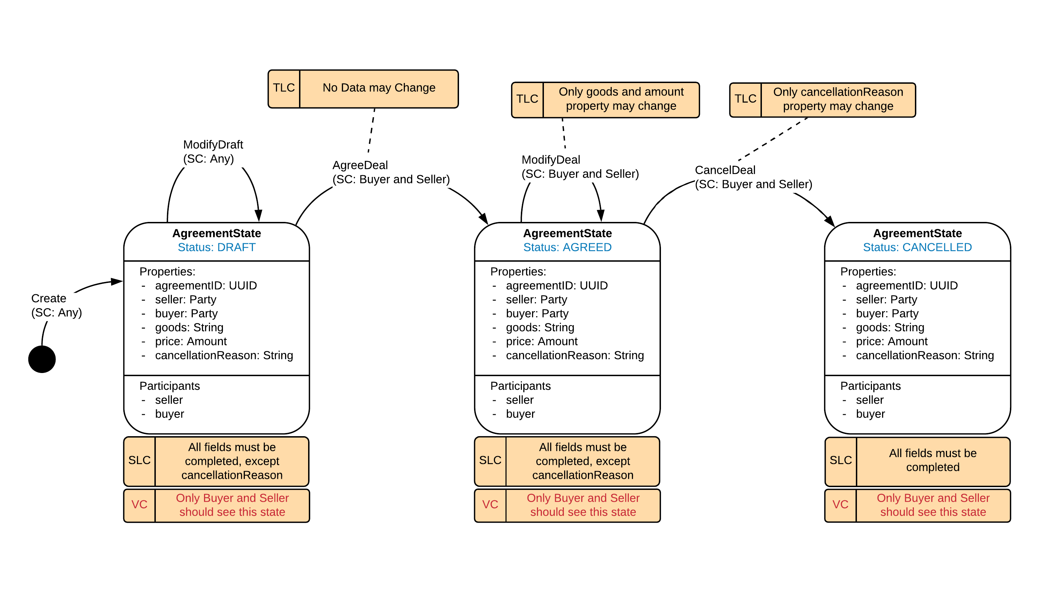

Slide 20
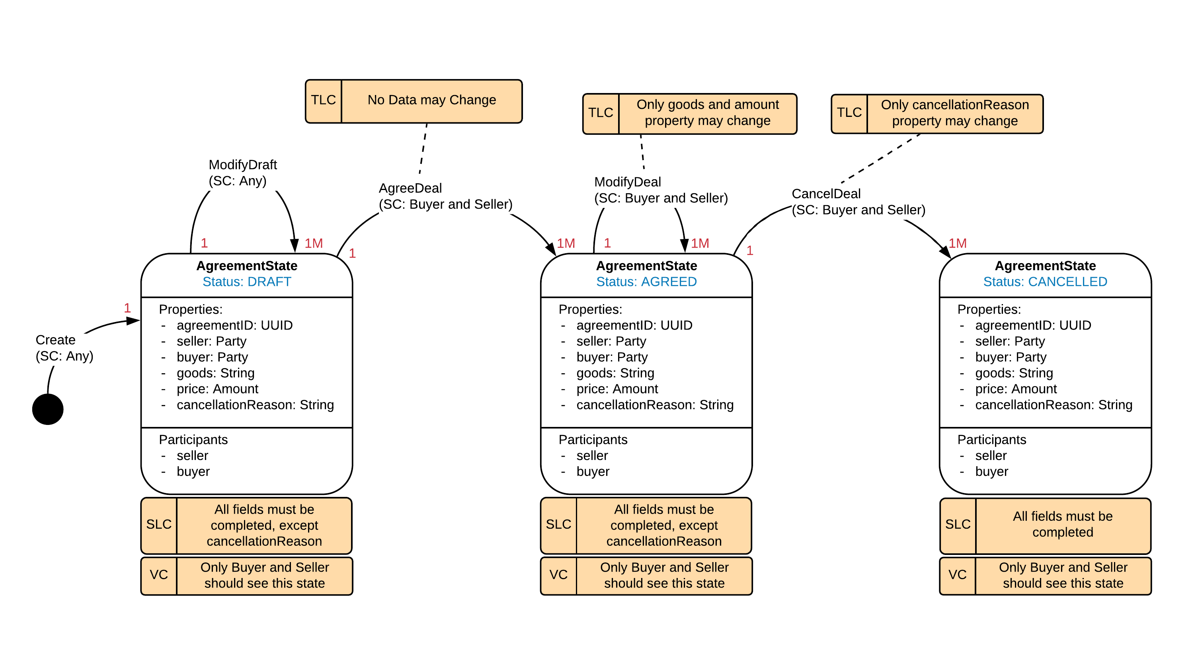

Slide 21


Slide 22
However….. Complication 1

Slide 23
This is not a true agreement of two parties

Slide 24

However…..
Node A
Node B
A
B

Slide 25
However…..
Node A
Node B
Initiate
A Buy B’s House for £1
A
B

Slide 26
However…..
Node A
Node B
???
Initiate
A Buy B’s house for £1
A
B
Sign: A
Verify()
Sign

Slide 27
However…..
Node A
Node B
Initiate
A Buy B’s house for £1
A Buy B’s house for £1
A
B
Sign: A
Sign: A
Verify()
Sign

Slide 28
However…..
Node A
Node B
Initiate
A Buy B’s house for £1
A Buy B’s house for £1
A
B
Sign: A
Sign: A
Sign: B
Verify()
Sign
Verify()
checkTransaction()
Sign

Slide 29
However…..
Node A
Node B
Initiate
A Buy B’s house for £1
A Buy B’s house for £1
A
B
Sign: A
Sign: B
Sign: A
Sign: B
Verify()
Sign
Verify()
checkTransaction()
Sign

Slide 30
However…..
Signing is automatic for the responder to a transaction
???
Node A
Node B
Initiate
A Buy B’s house for £1
A Buy B’s house for £1
A
B
Sign: A
Sign: B
Sign: A
Sign: B

Slide 31
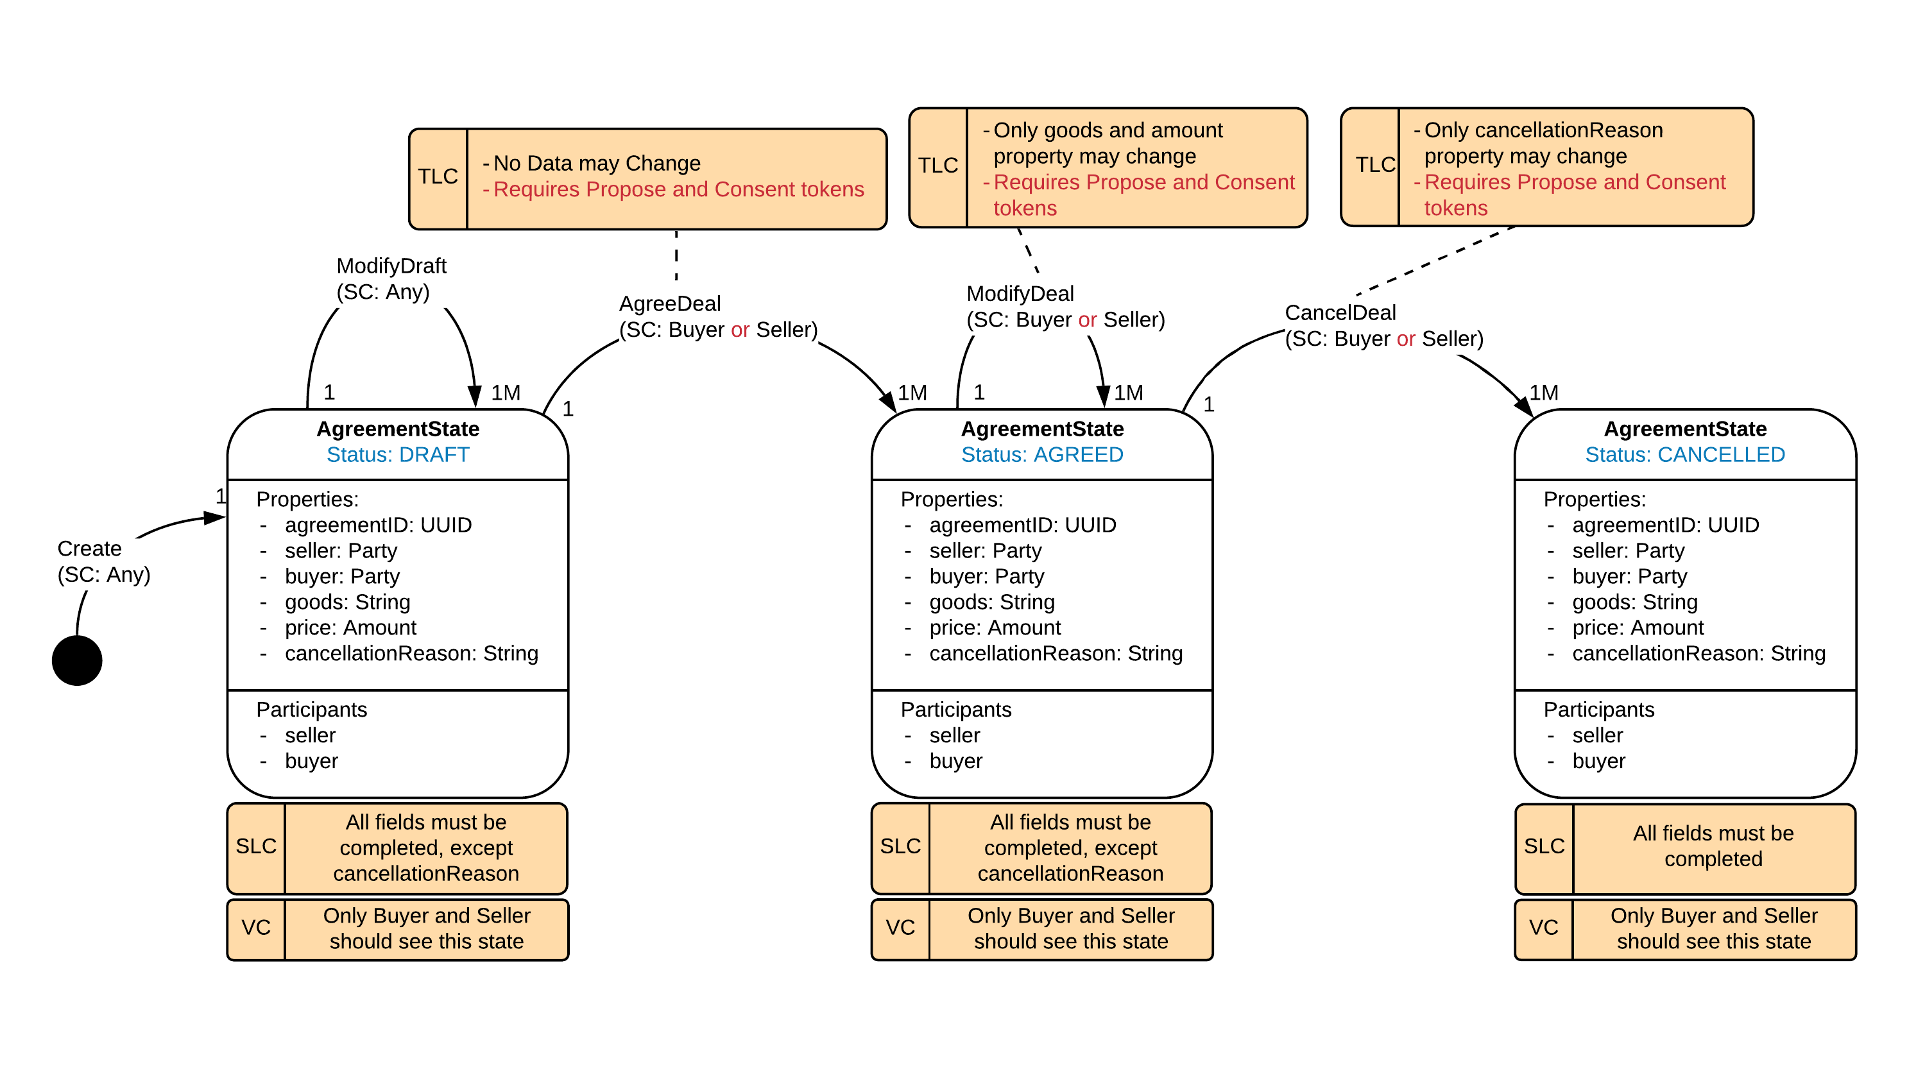

Slide 32
Solution – Propose-Consent Pattern
Transaction Instance View
Or ‘drawing transactions’

Slide 33
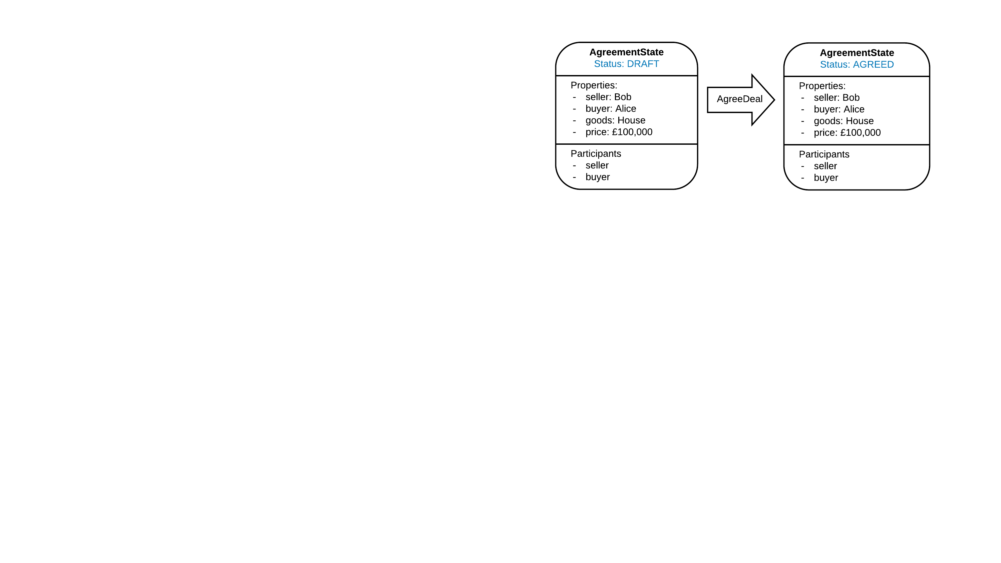

Slide 34
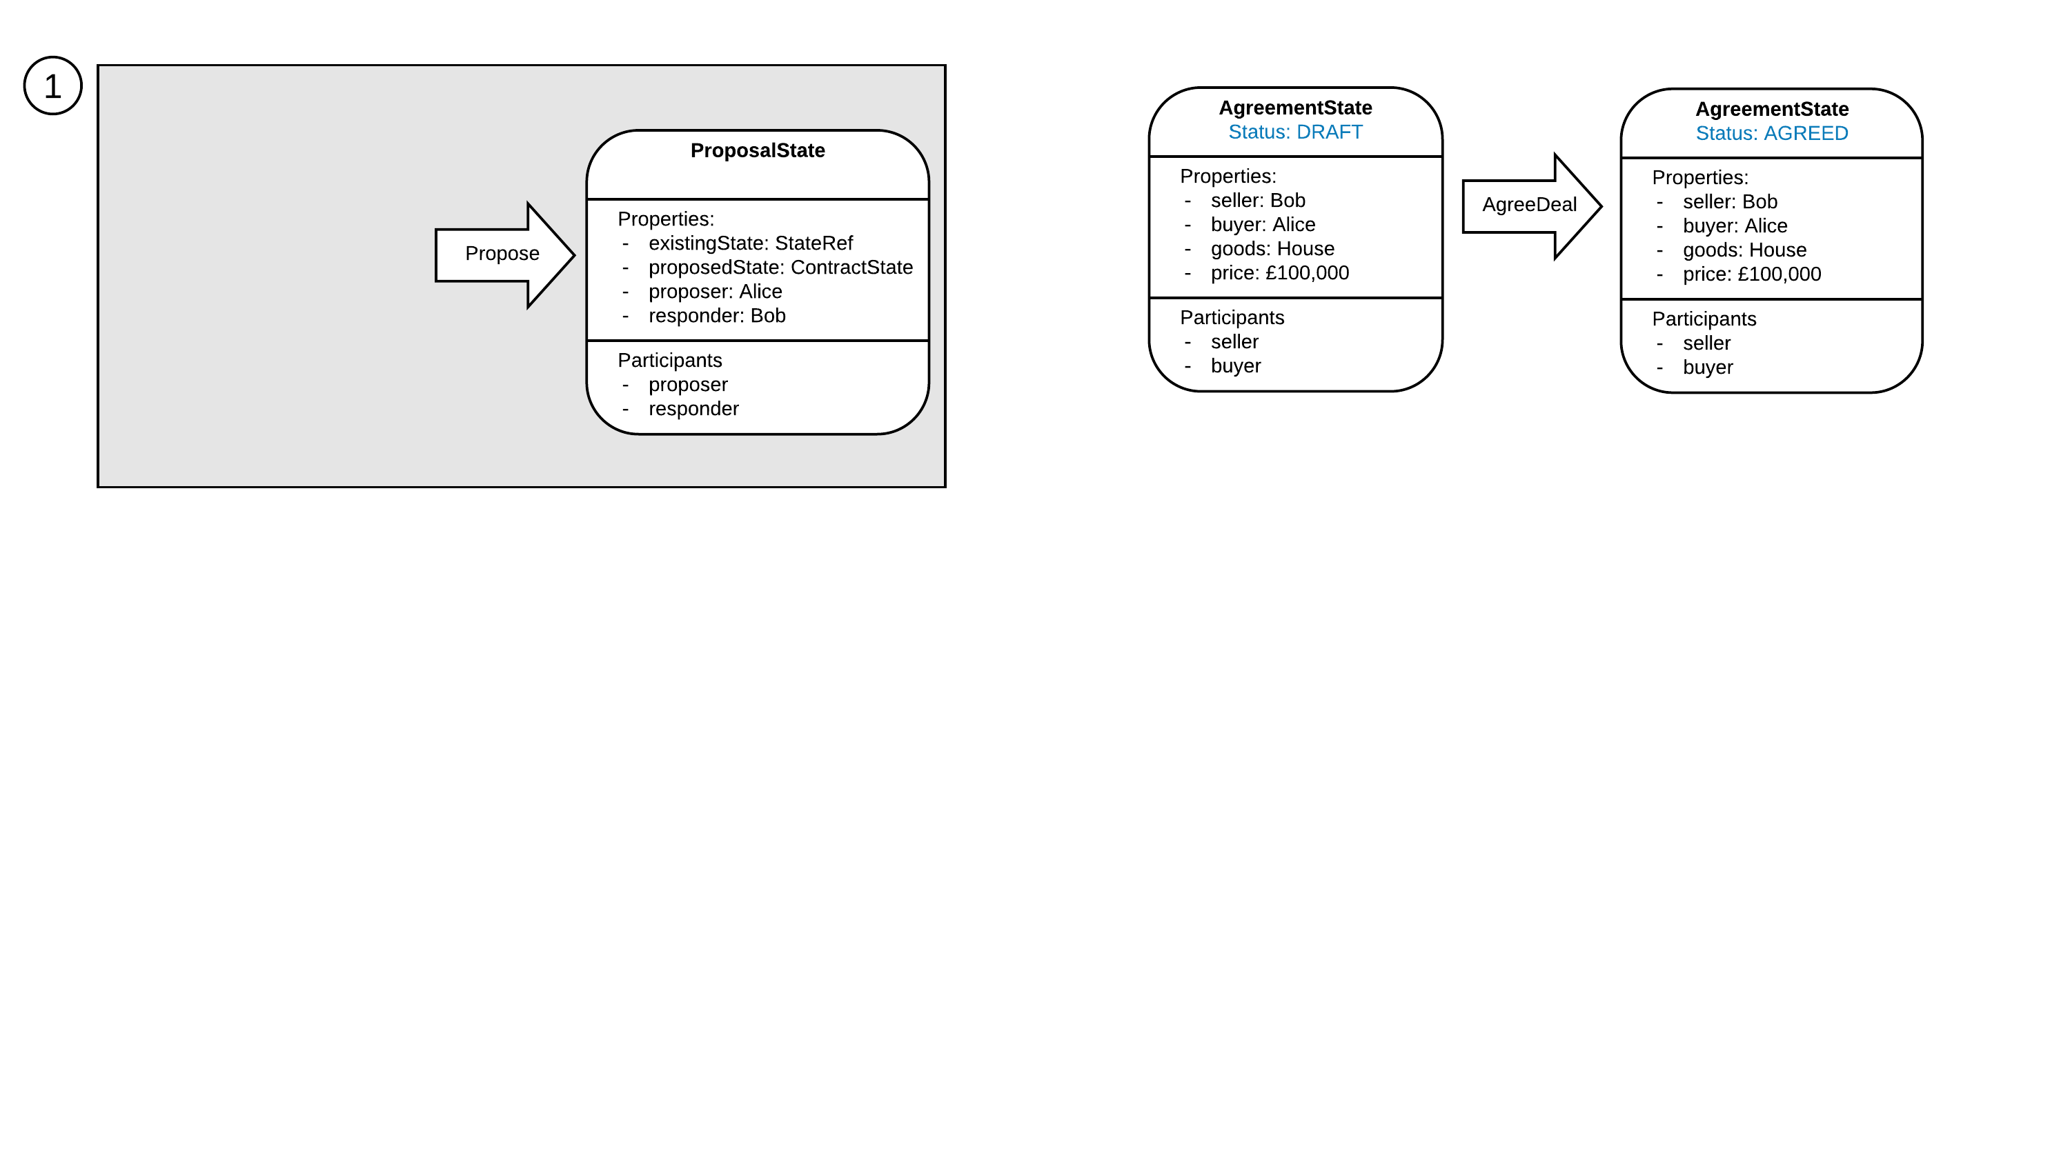

Slide 35
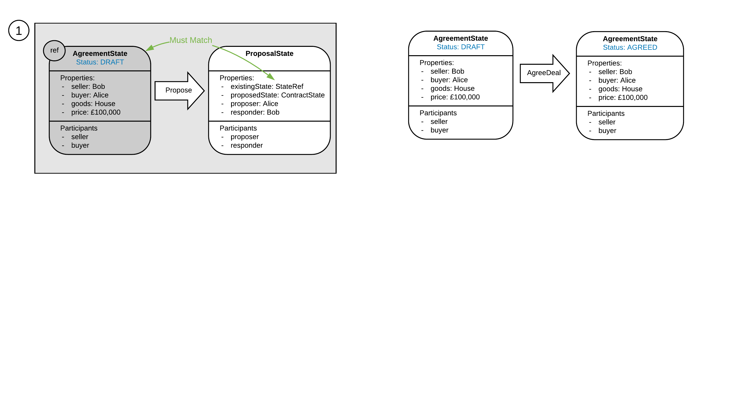

Slide 36
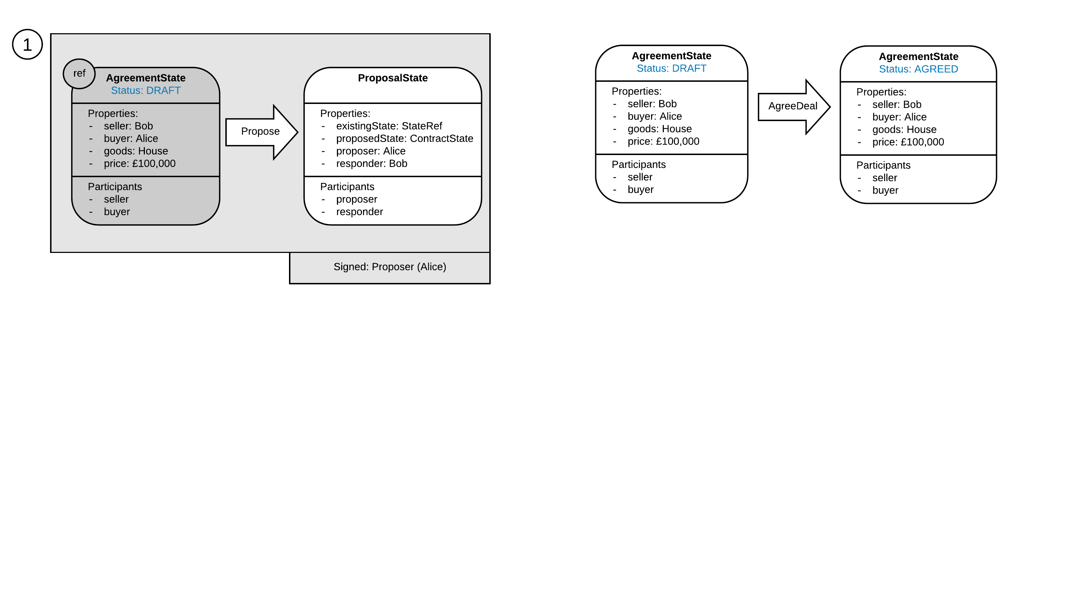

Slide 37
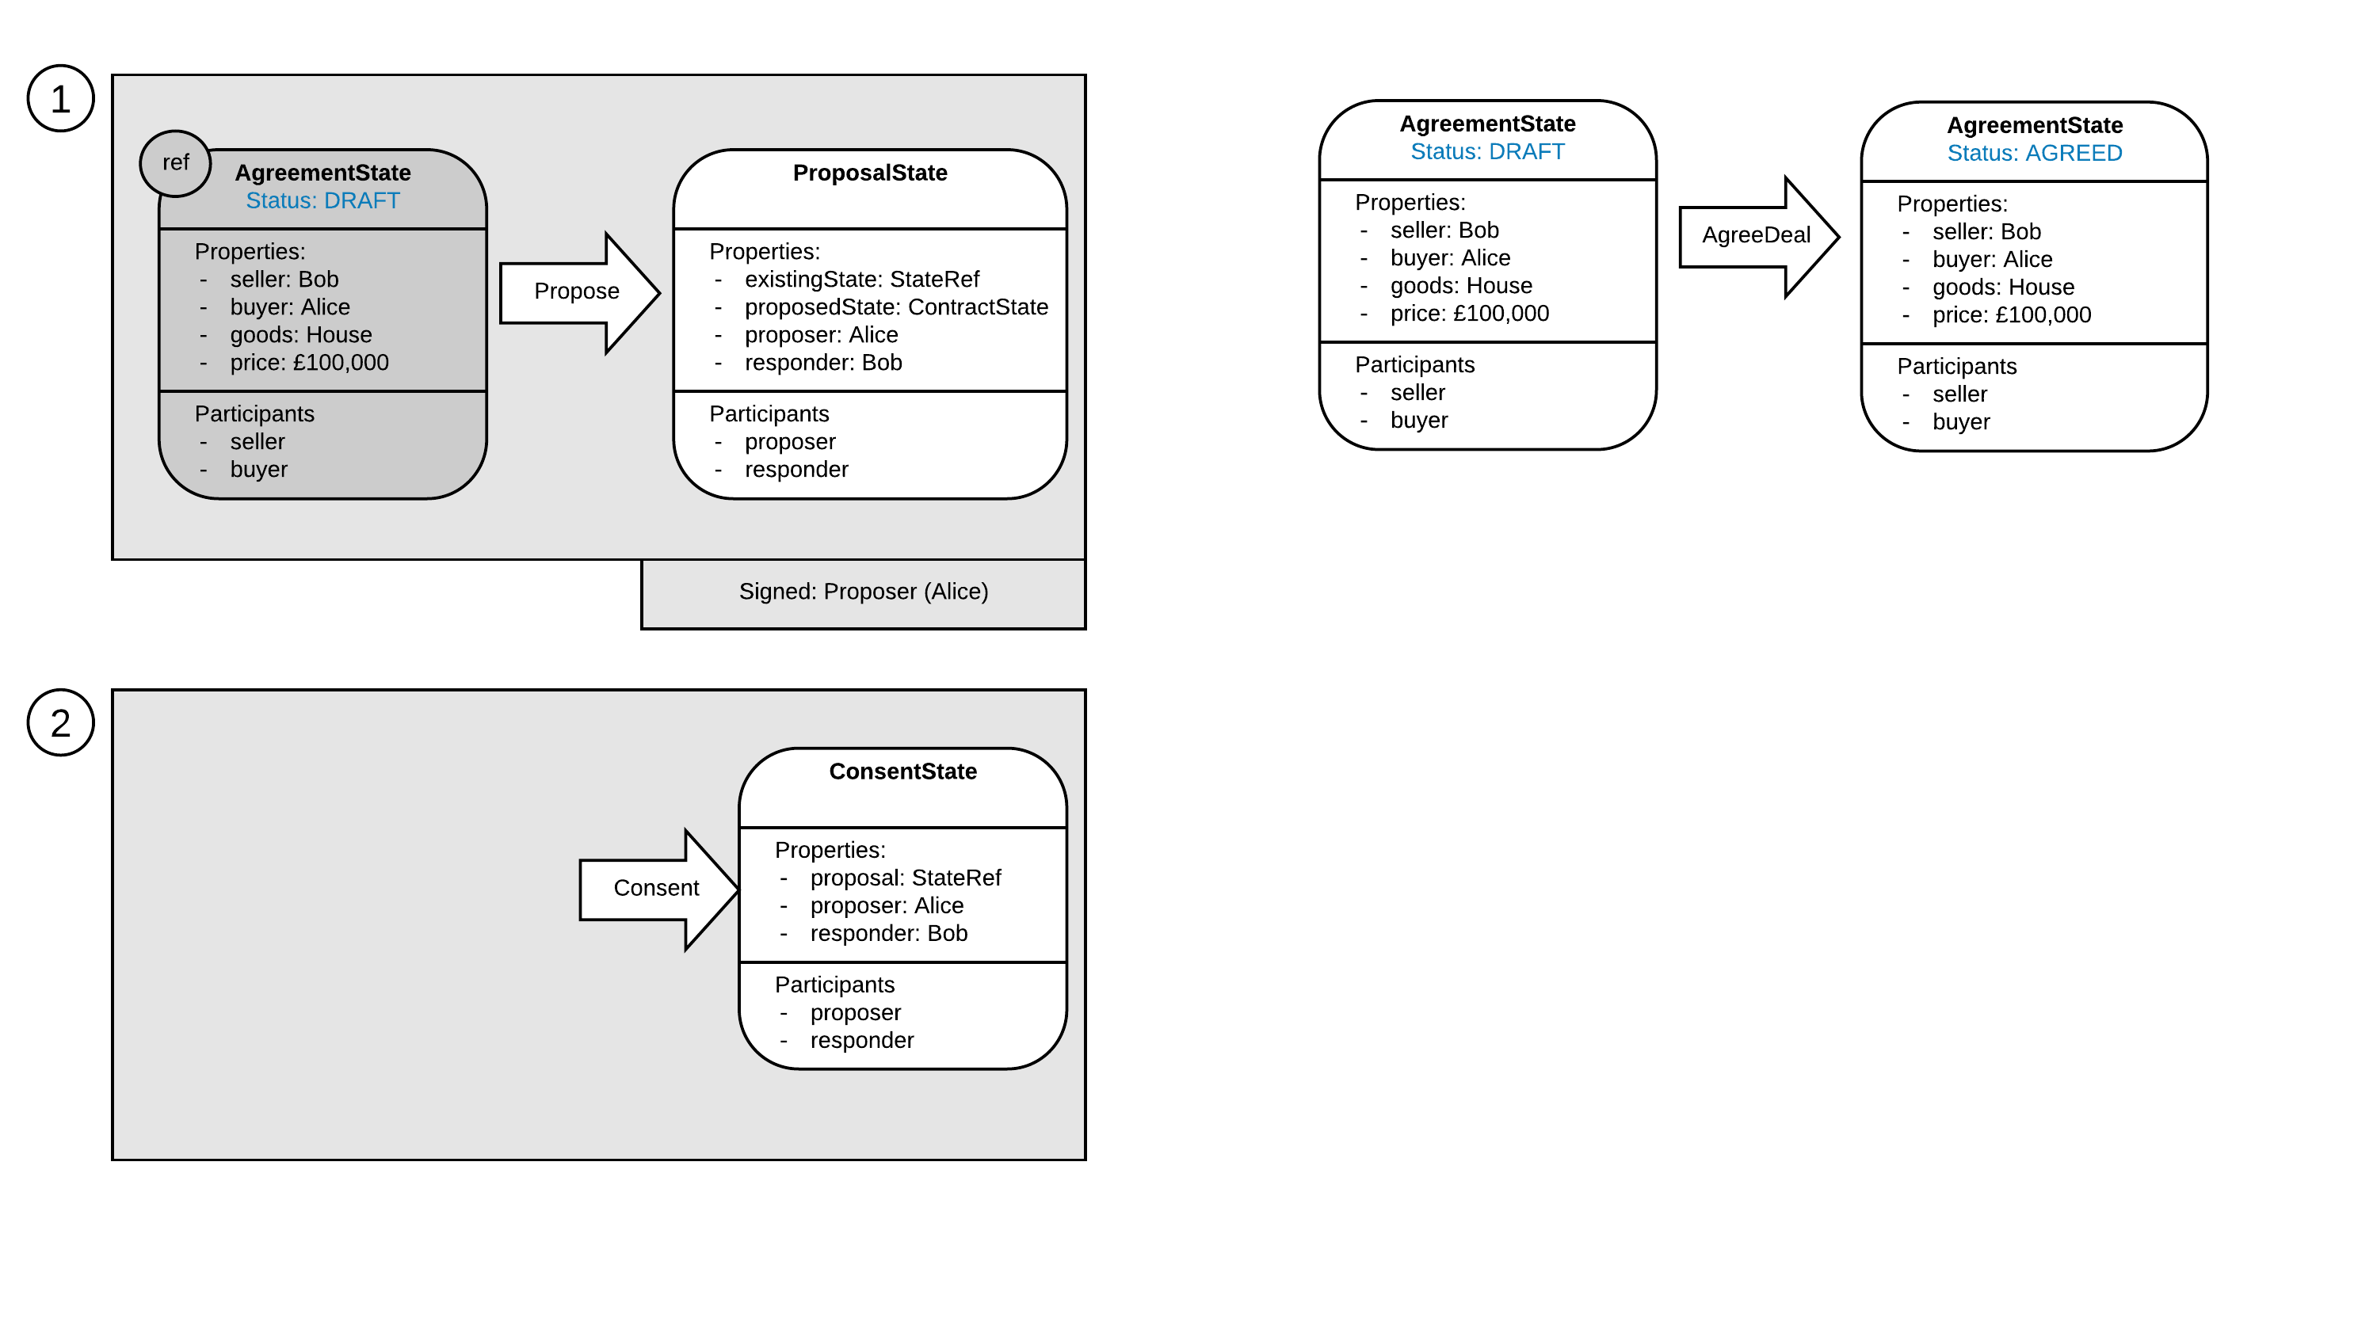

Slide 38
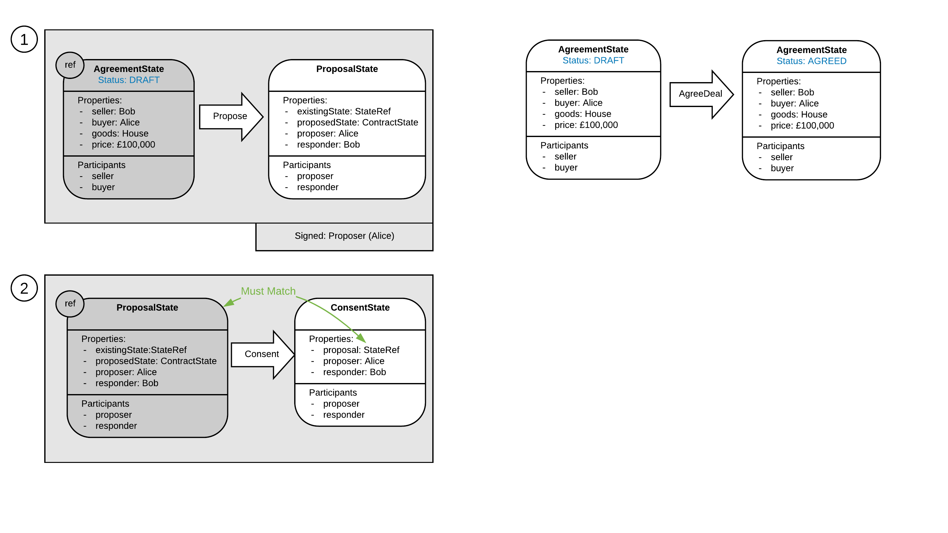

Slide 39
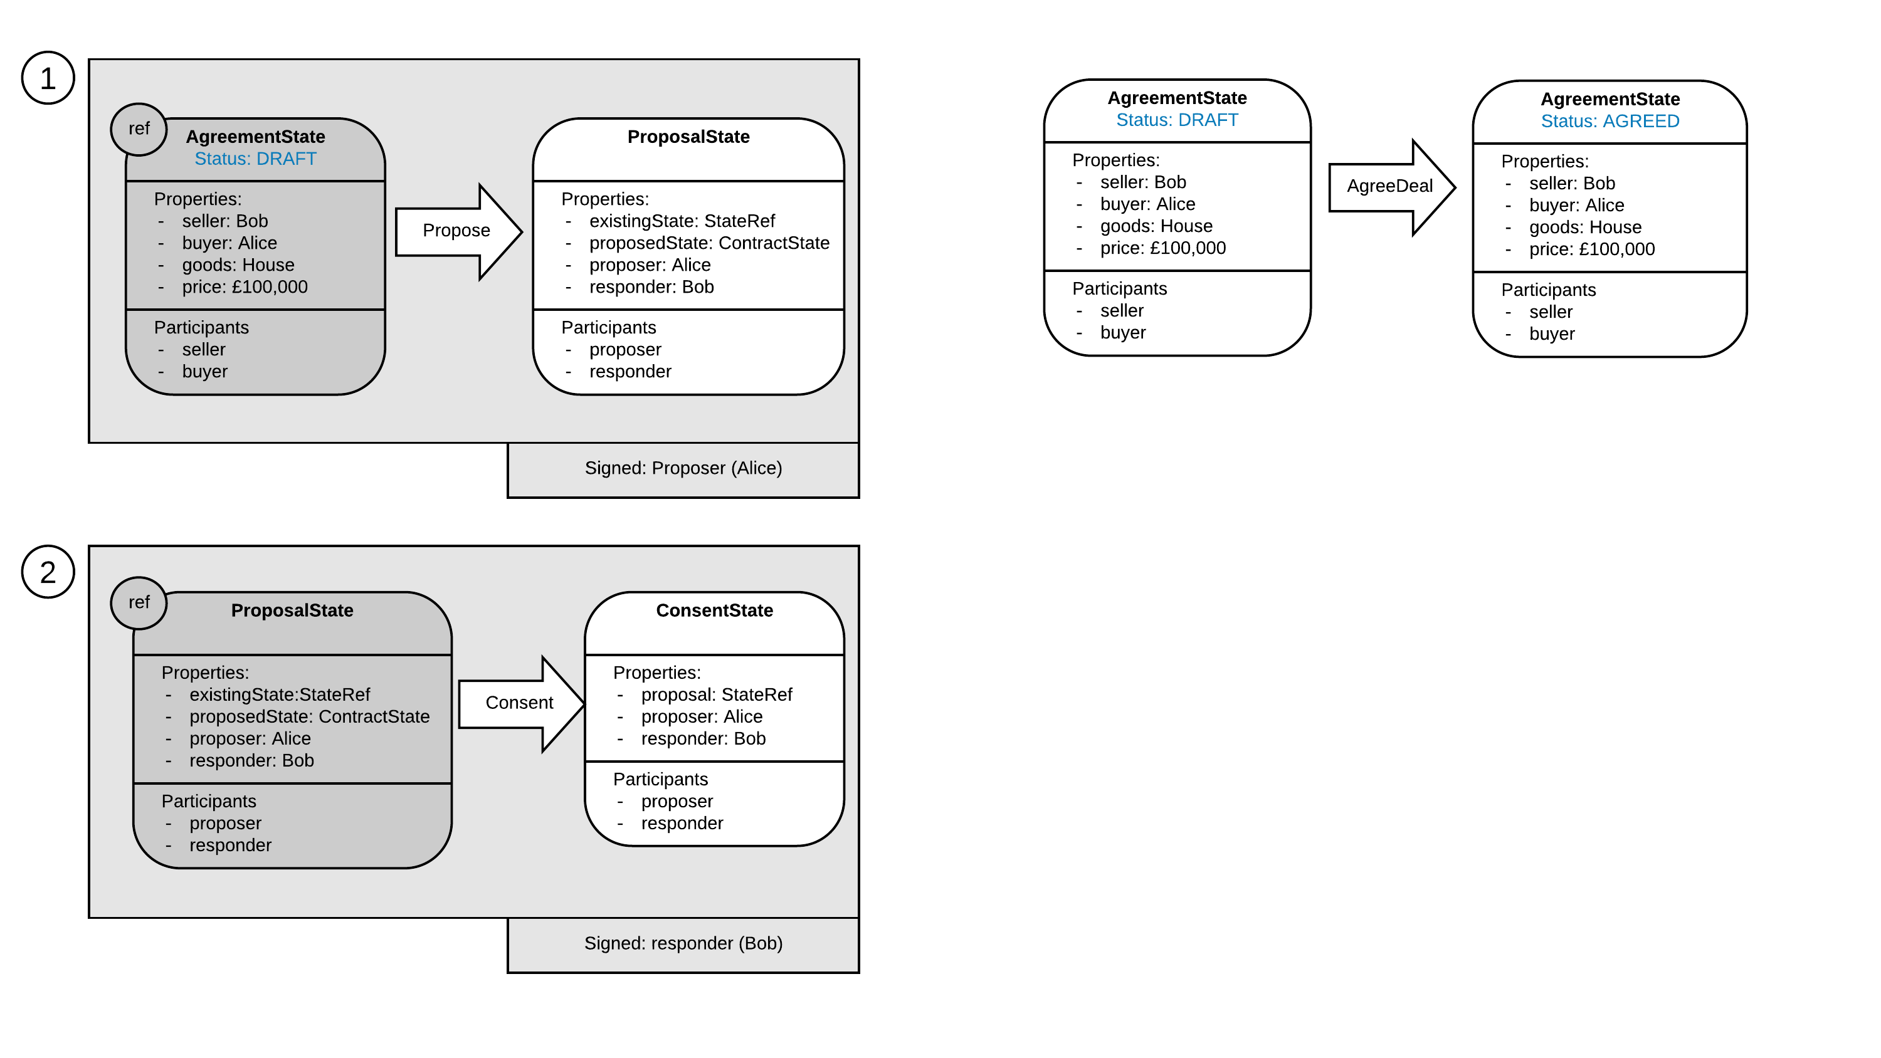

Slide 40
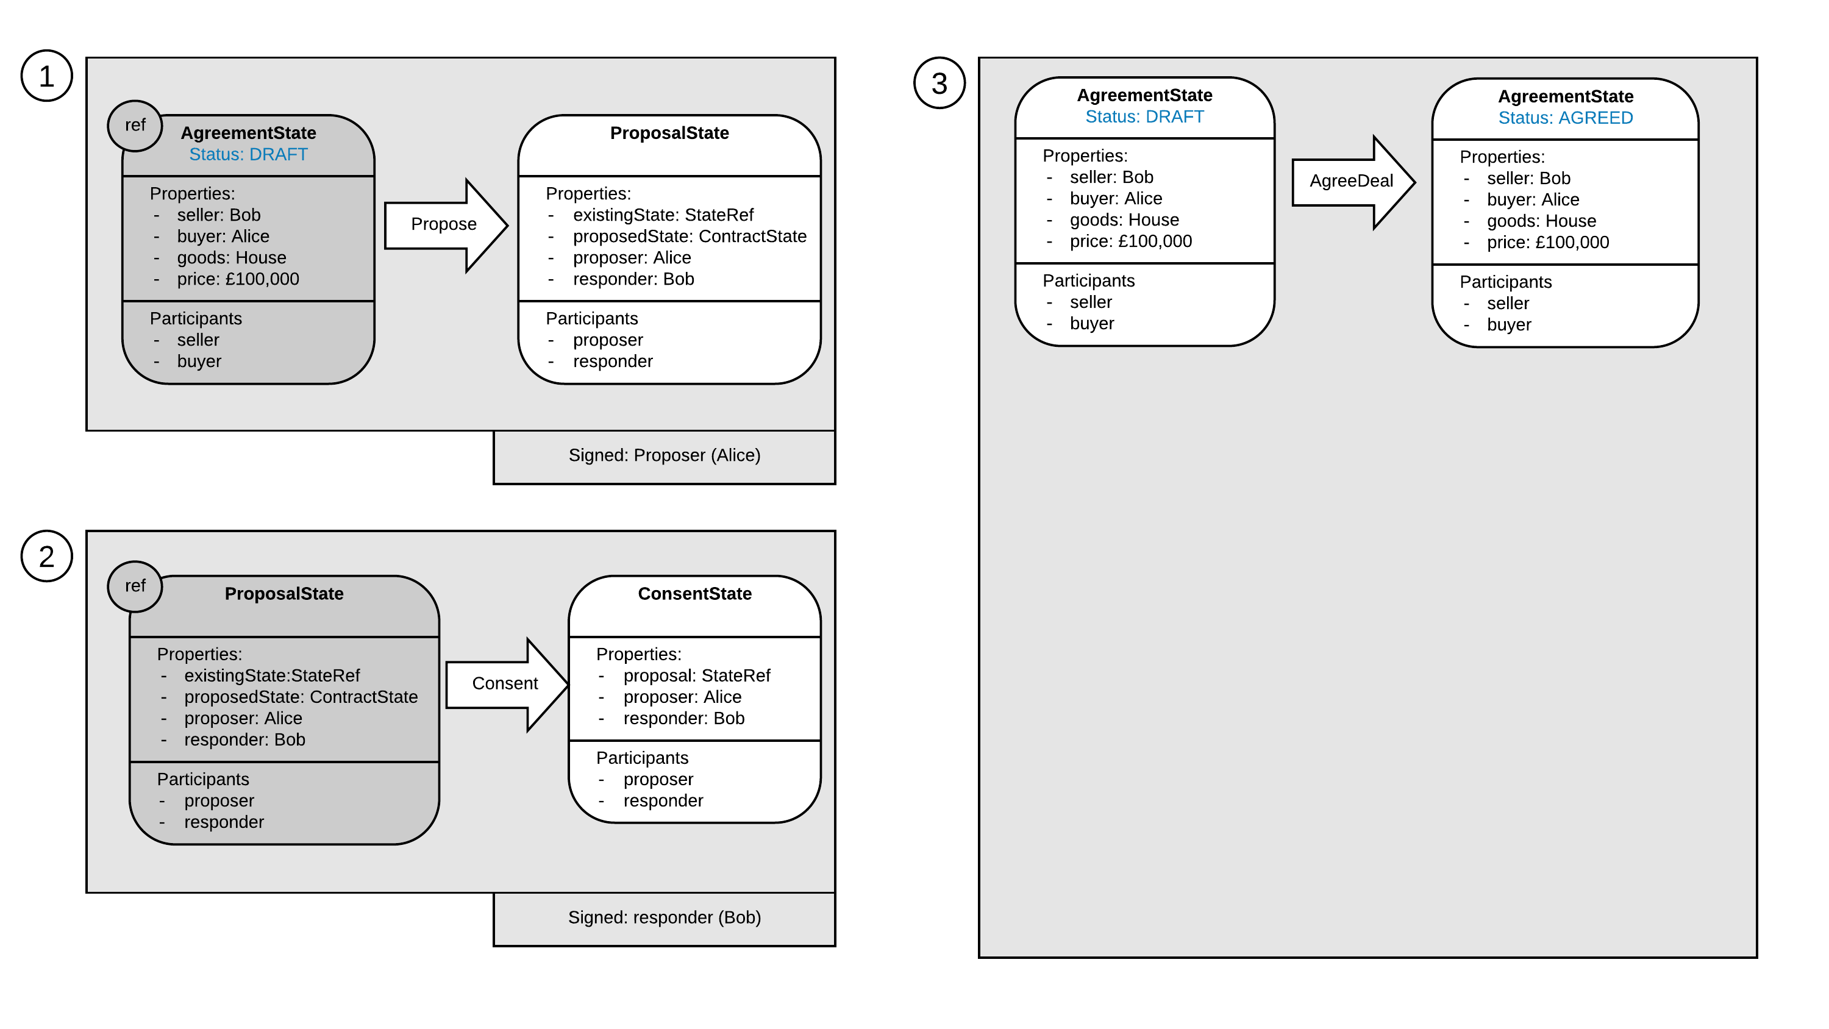

Slide 41
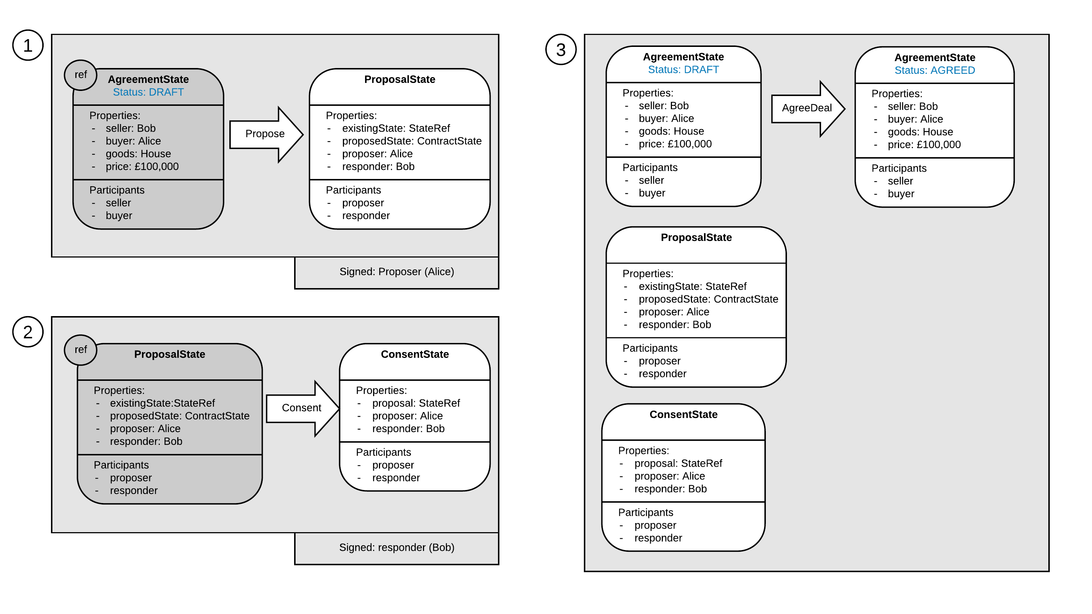

Slide 42
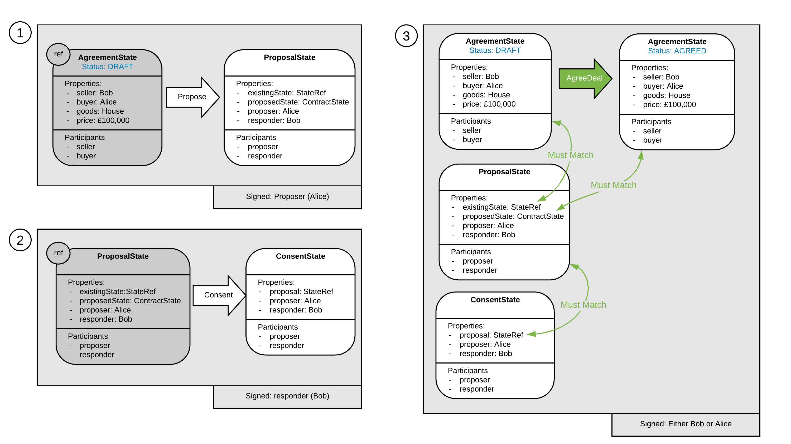

Slide 43
Complication 2
The Business Network Operator wants paying
Specifically they want to charge each time a deal is initially agreed

Slide 44
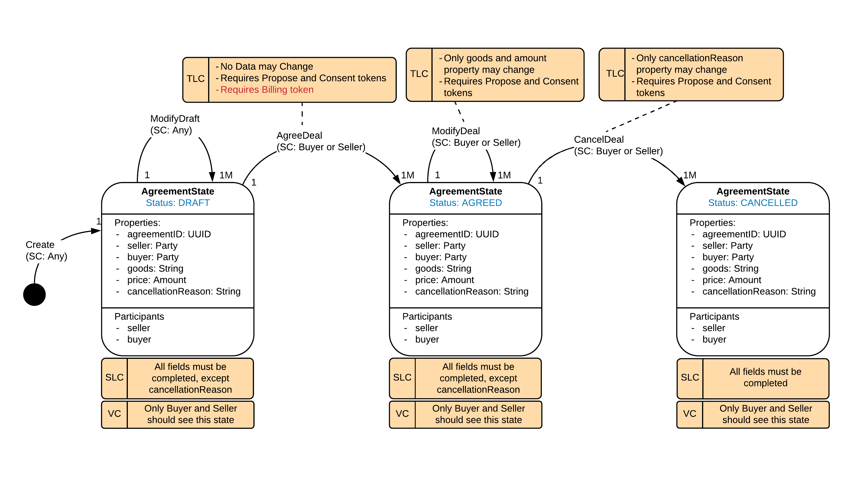

Slide 45
Problem solved… or is it?
State Evolution View
Or… ‘State Machines in Action’

Slide 46
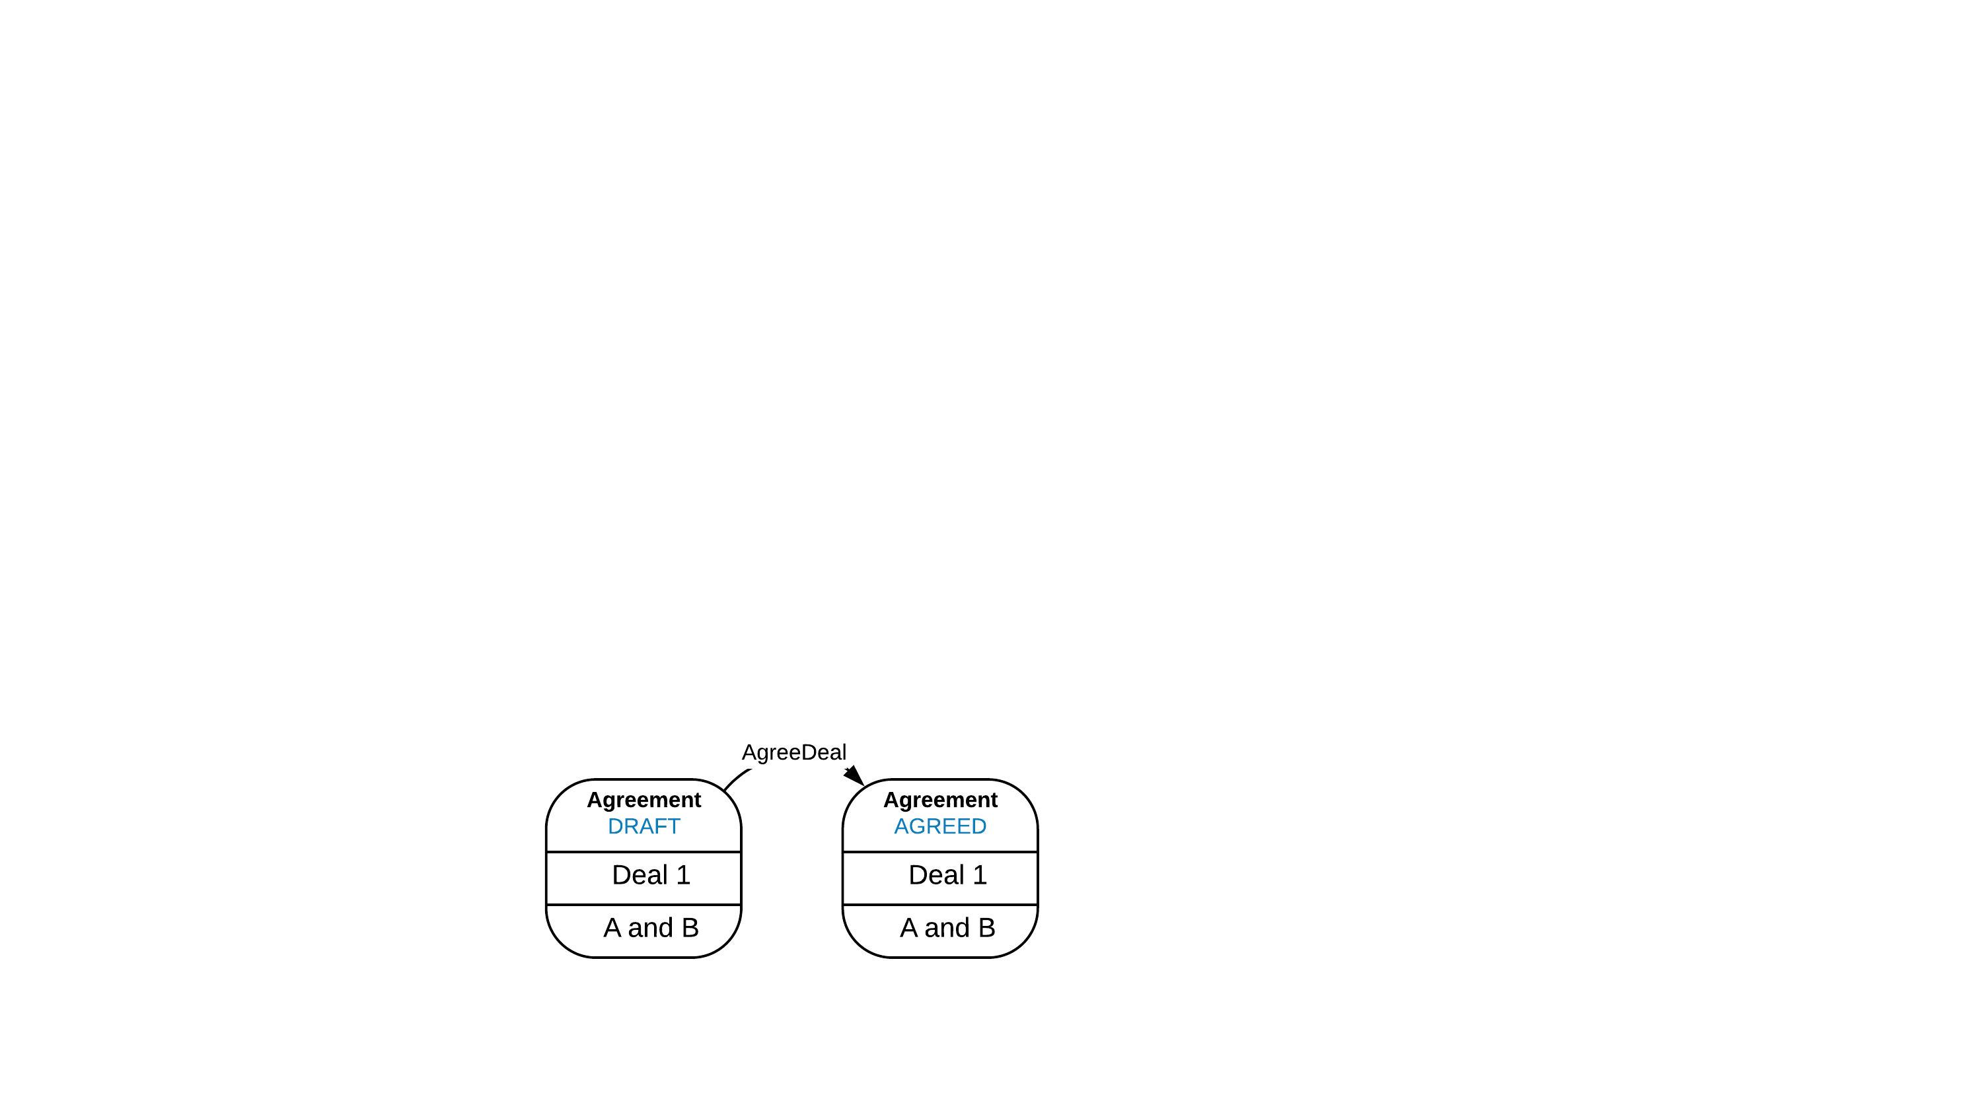

Slide 47
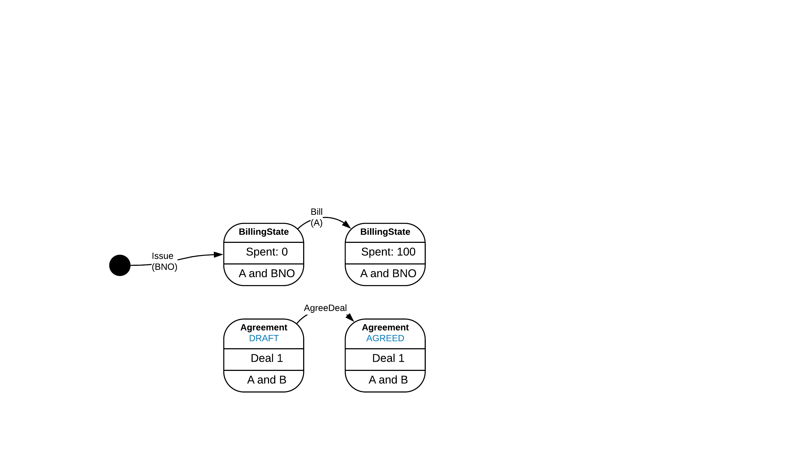

Slide 48
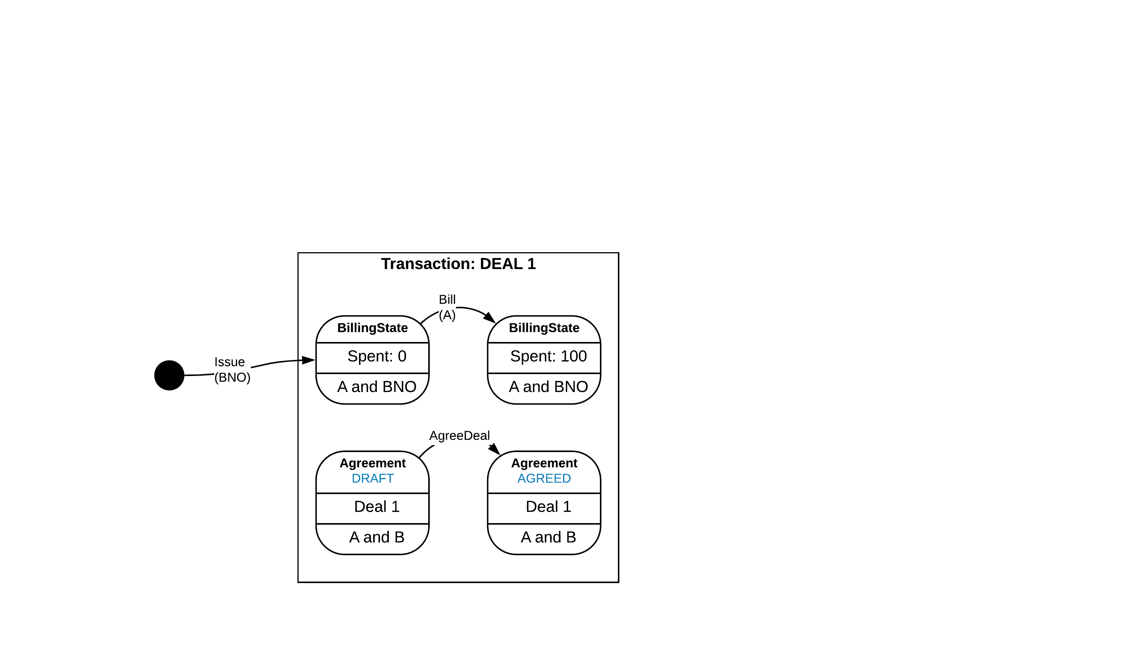

Slide 49
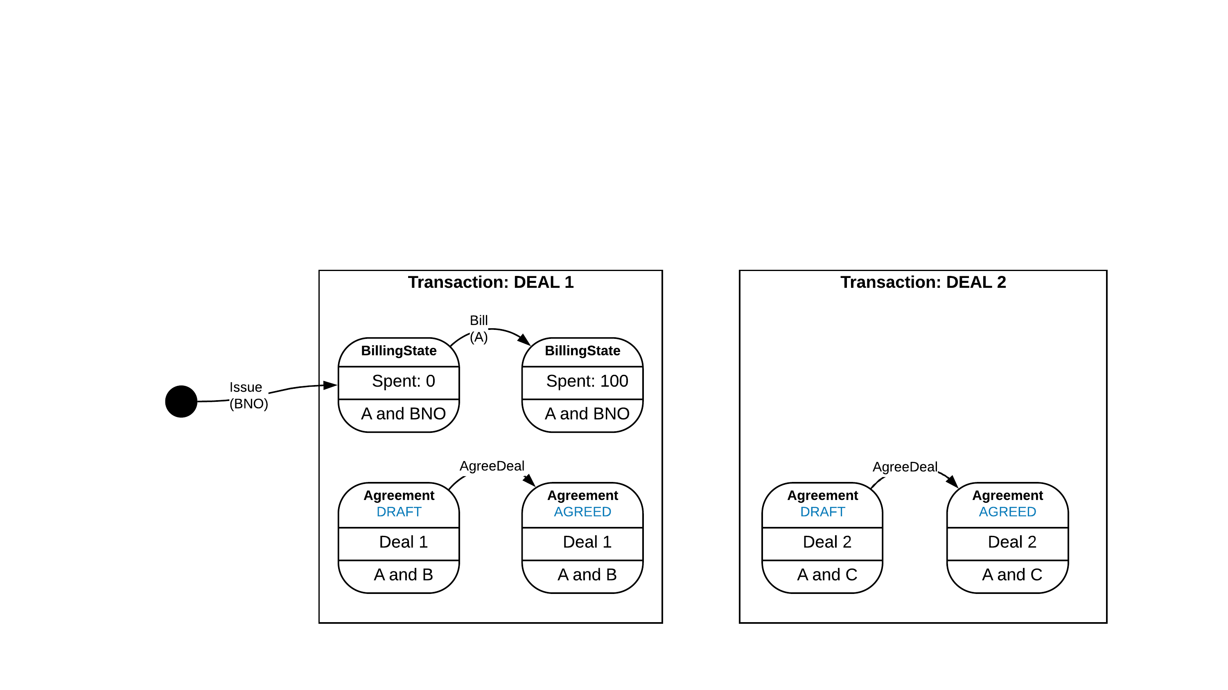

Slide 50
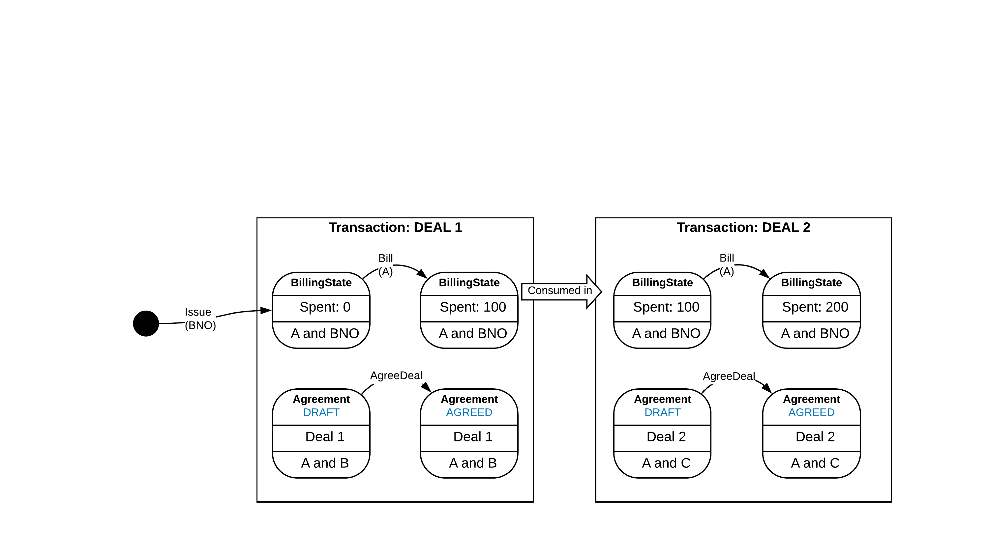

Slide 51
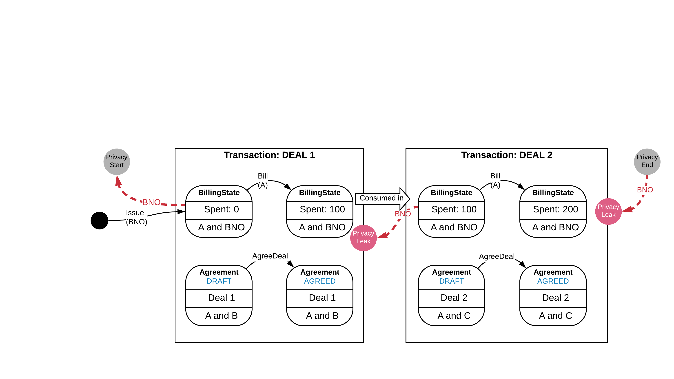

Slide 52
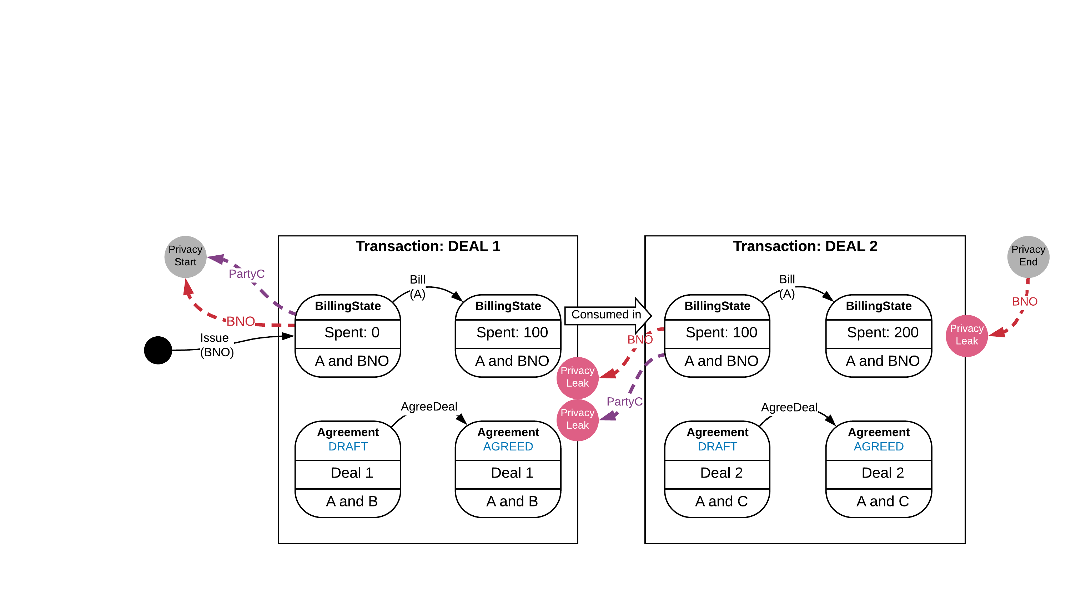

Slide 53
Party C ends up with Party B’s private Deal in their vault

Slide 54
Party C ends up with Party B’s private Deal in their vault
This is NOT okay!!

Slide 55
So… How do we fix this?

Slide 57
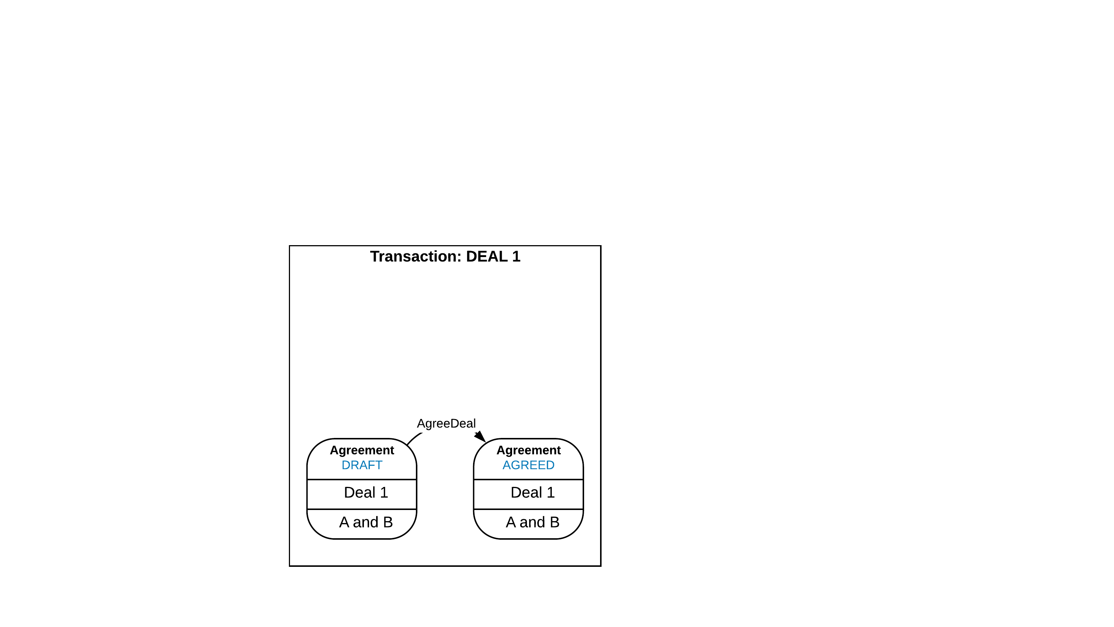

Slide 58
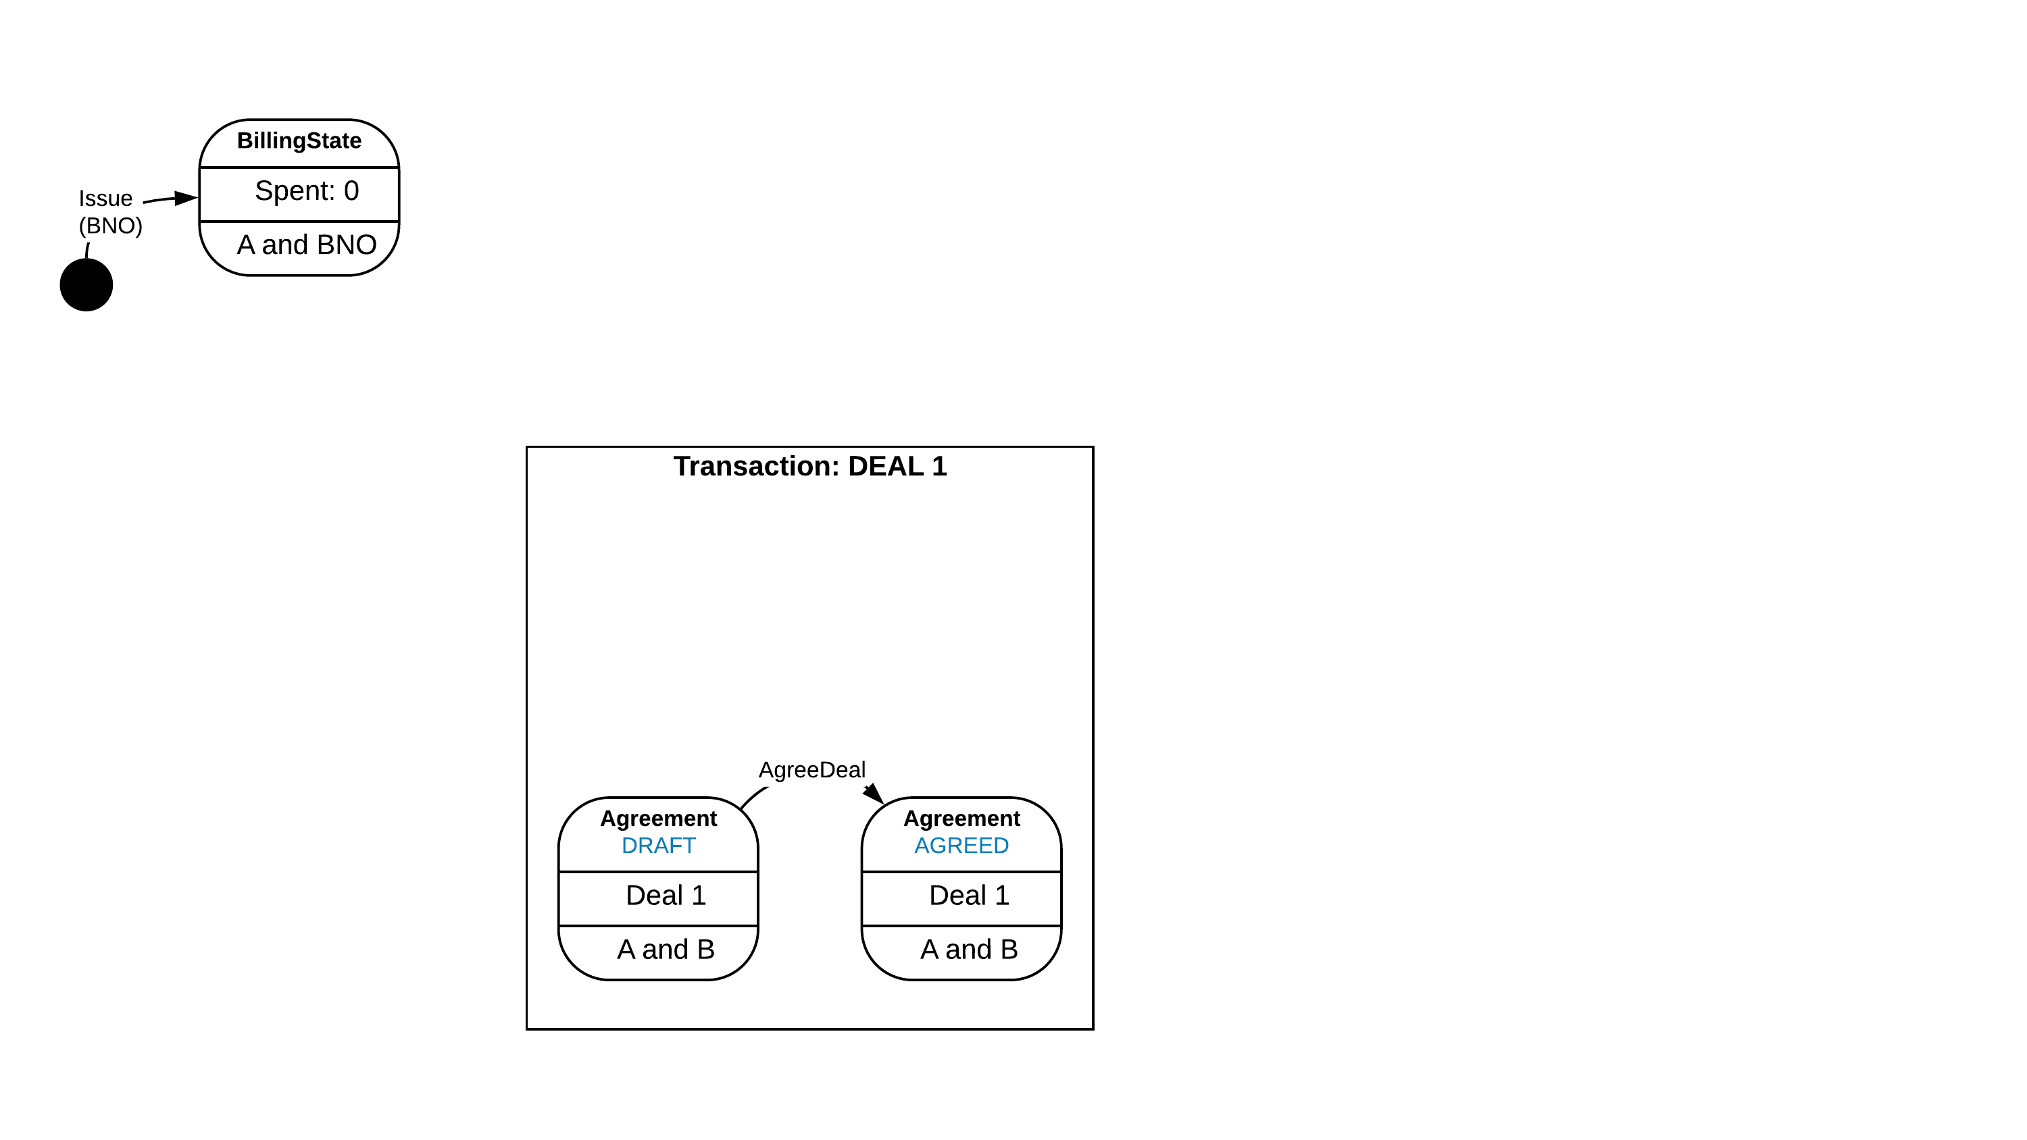

Slide 59
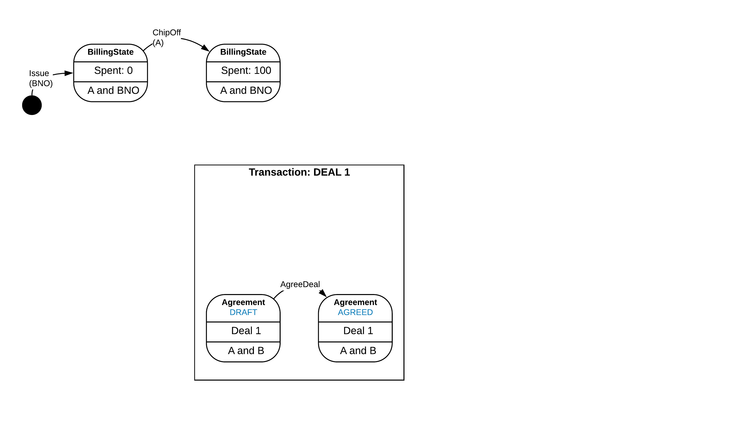

Slide 60
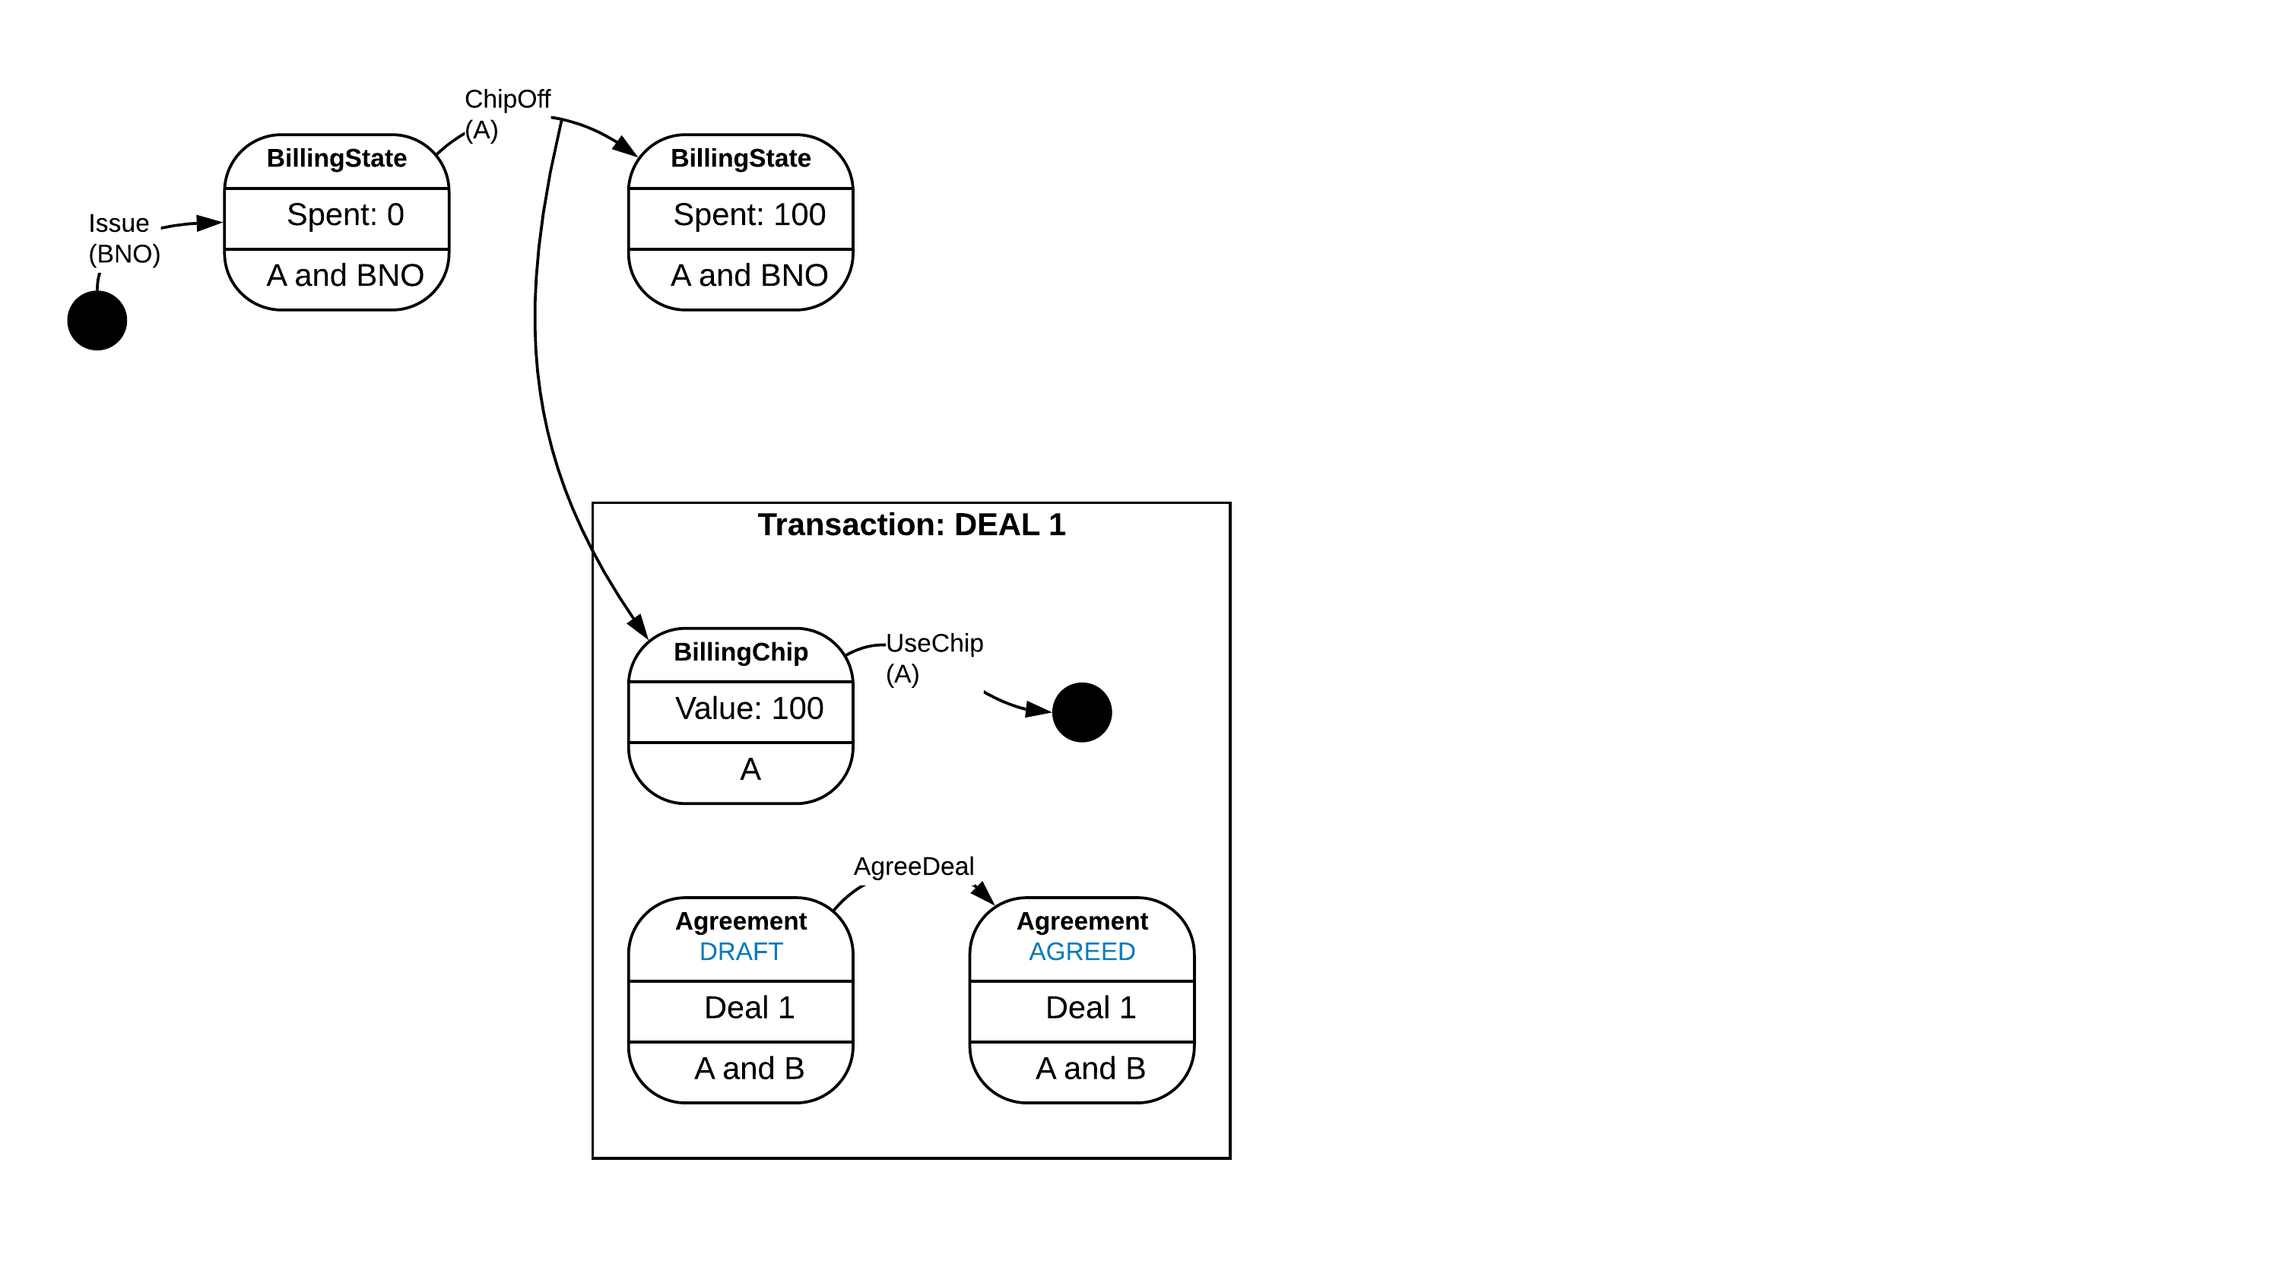

Slide 61
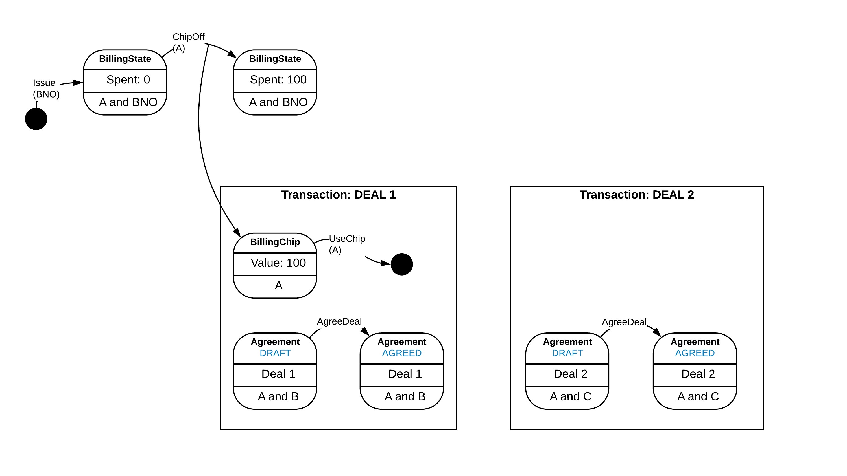

Slide 62
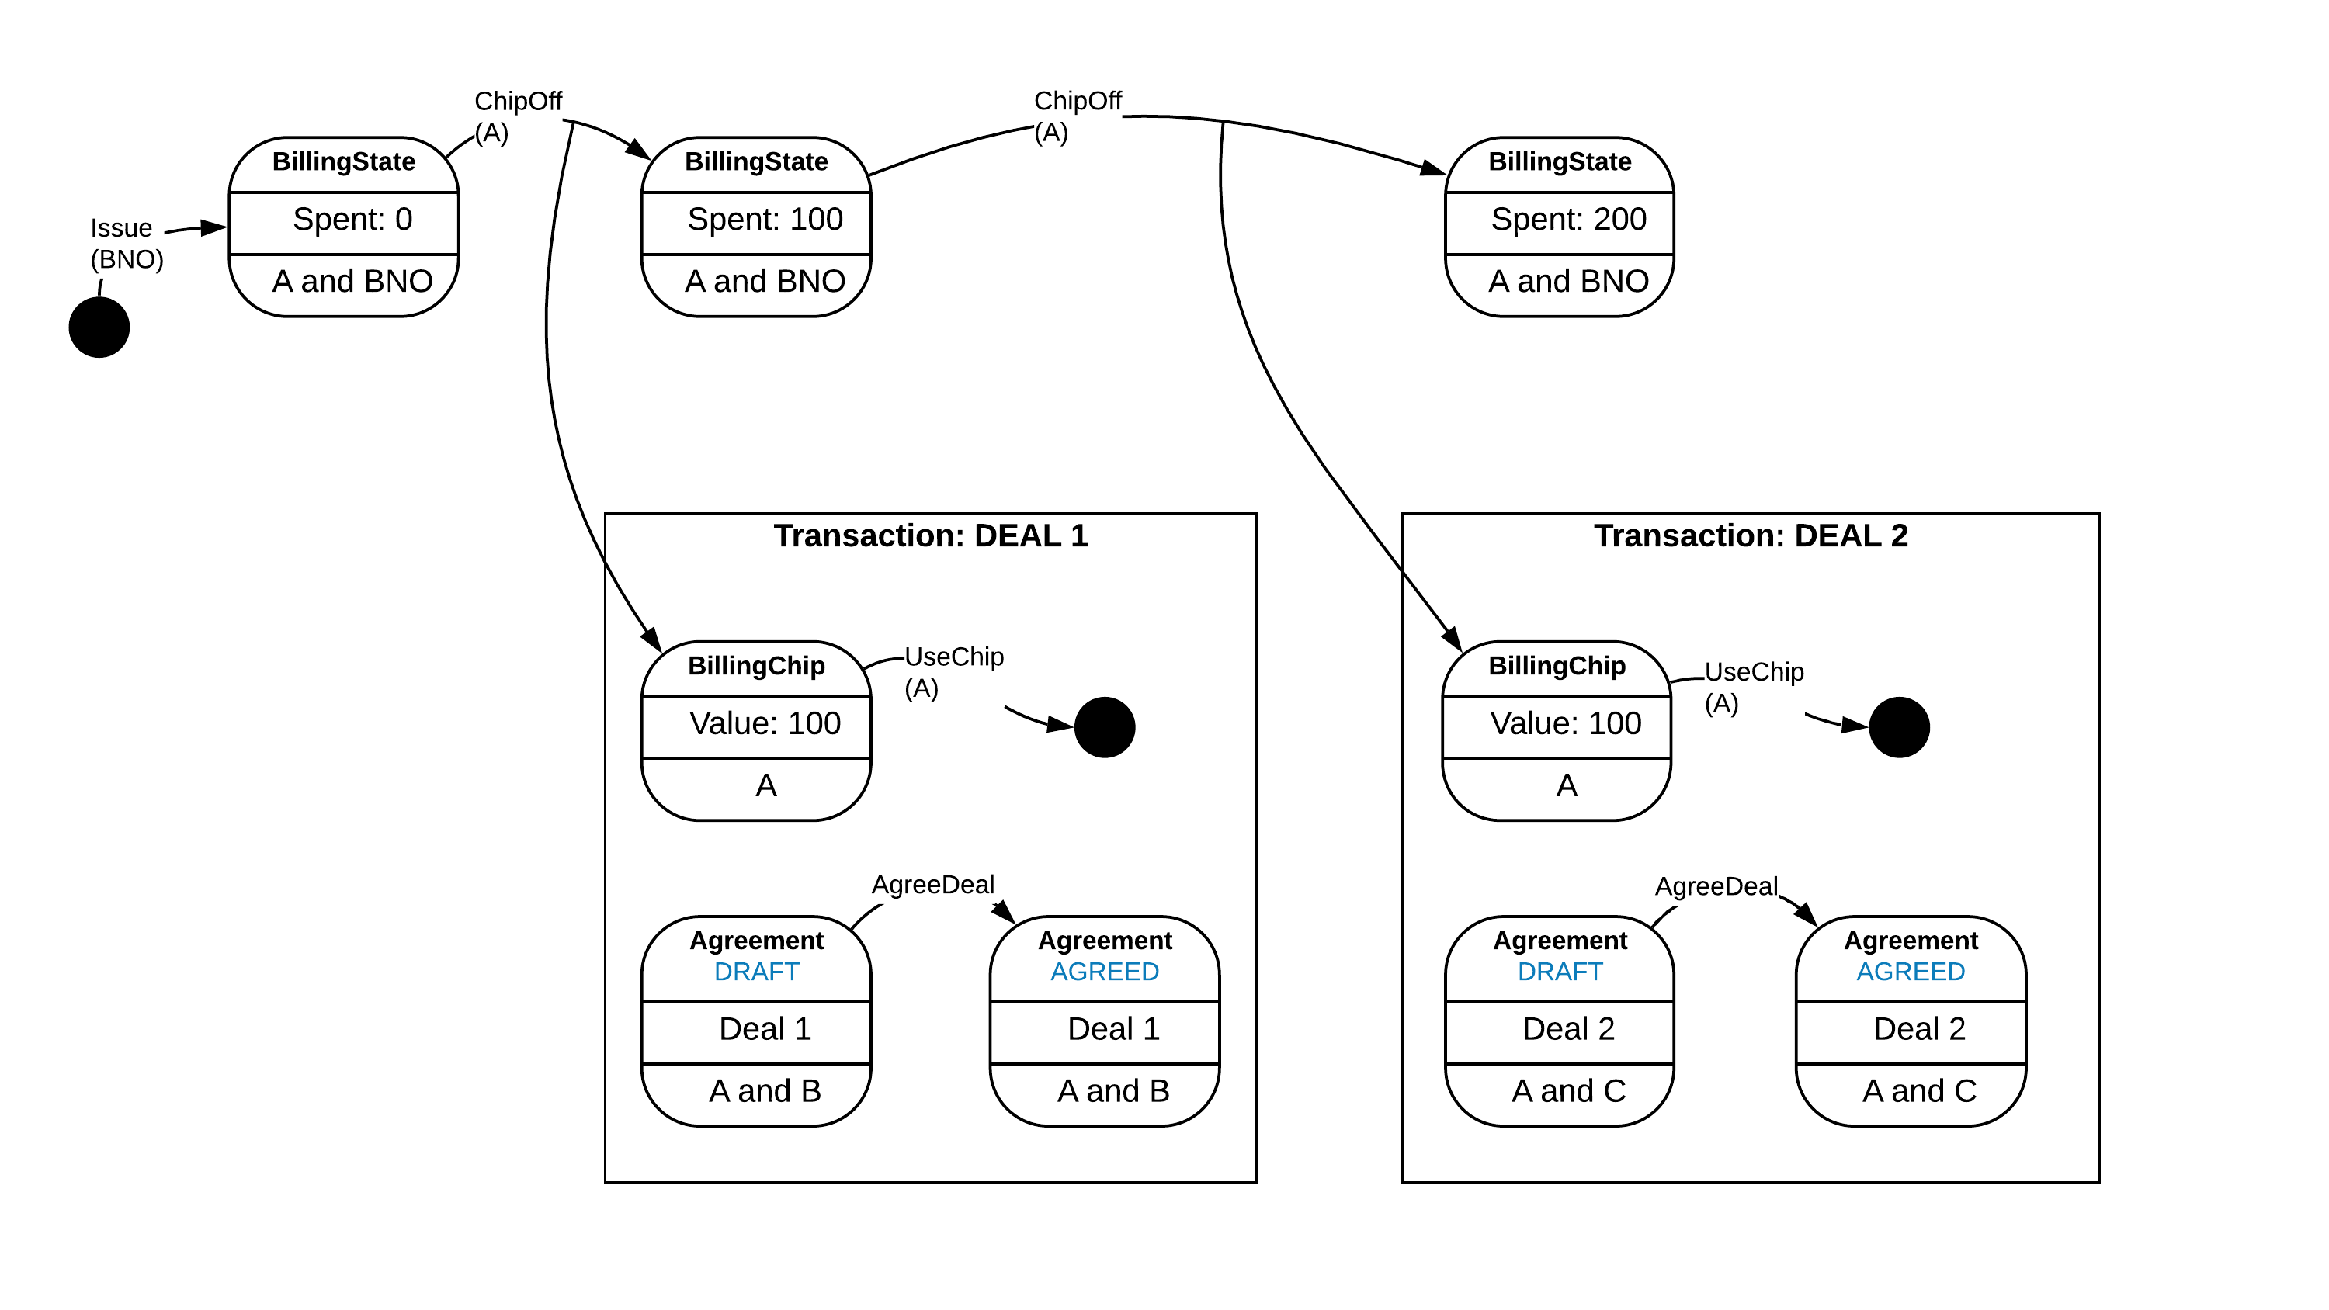

Slide 63


Slide 64


Slide 65


Slide 66
Takeaways
CorDapp Design Language (CDL) is here to help you write better, more robust CorDapps
It allows you to
Describe complex production grade Smart Contracts
Show Smart Contracts in action
Reason about Privacy
Also views for the Orchestration layer (not covered here)

Slide 67

For more information
See the Corda Solutions DocSite: https://solutions.corda.net/
Publishing a CDL template soon

